Slide 1
Chapter 2
Customer Service

Slide 2
Chapter 2: Customer Service
2.1 Understand Customer Service
Define quality customer service
Discuss the importance of quality customer service

Slide 3
What is Customer Service & Why is It Important?
Customer Service is a series of activities designed to enhance the level of customer satisfaction so that the customer feels that a product/service meets their needs and expectations.
A Customer Service Association applies a combination of planning, problem-solving, decision-making, critical thinking, professionalism, respect and more to give a customer more
than they expect and deliver an experience they will want to
share with others.

Slide 4
What is Customer Service & Why is It Important?
It is important because good Customer Service increases sales, sales increase revenue, increased revenue means jobs,
and increased revenue also means more money for pay increases and bonuses.
By continually learning all you can about the products you sell, your confidence in selling these products will increase. You’ll eventually become the expert and create “raving fans” who keep Coming back and referring others to do business with you.

Slide 5
Chapter 2: Customer Service
2.2 Learn About Products and Services
Examine how seeking out and participating in training opportunities helps associates
Learn to build recommendations for customers by testing or sampling products and services Discuss researching and reviewing relevant data on competitors’ products and/or services
Explain the importance of remaining current regarding products, services and industry standards

Slide 6
Company-Provided Product and Services Training
As a retail employee, you are responsible for helping satisfy customer needs and resolving problems.
Attend any training offered by your company to help ensure that you are prepared to do this.
Study the layout of your store. Customers often need help locating a product. Give them specific directions and if possible, walk with the customer to that area.

Slide 7
Company-Provided Product and Services Training
Learn about the products you sell by:
Study the product information from the manufacturer
Use the product or service to gain first-hand experience
Understand any safety requirements
Anticipate questions your customer might have and research answers to those questions
Keep notes or checklist to help you (when needed)
Tip: be sure you are “speaking the same language” as your customer. Don’t use technical terms they don’t understand.

Slide 8
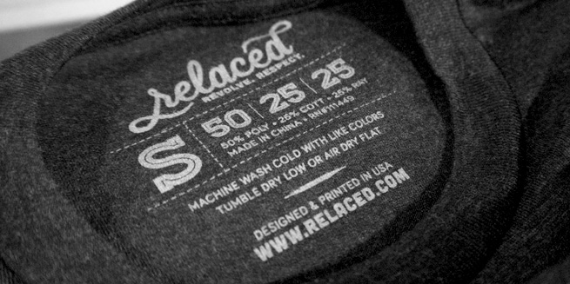
Company-Provided Product and Services Training
Written and Multimedia Material About Products/Services
Your company, the manufacturers and suppliers often develop written and multimedia materials about the products you sell.
Look up product reviews online.
Read catalogs and product labels/booklets/manuals

Slide 9
Company-Provided Product and Services Training
The more you learn about your products, the more you will sell. If you work on commission, that’s money in your pocket. Remember knowledge is power.
Commission-many sales people get paid a commission on what they sell. A commission is a percentage of total sales paid to a sales person.

Slide 10
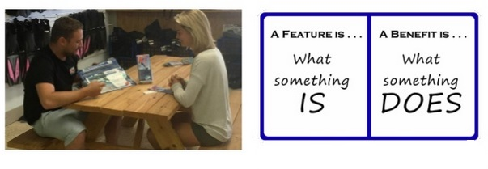
What are Product Features and Product Benefits?
Product Feature-physical attributes of a product (color, size, materials it is made from, function, etc.). These answer the question of “What?”
Product Benefits-given by a sales associate that explain the features in a way that shows the customer the advantages or rewards of a product. These answer the question of “Why?”

Slide 11
Turn Features into Benefits
Feature: neutral colors: beige, ivory, gray
Benefit: goes with everything, doesn’t stand out, low maintenance
Feature: 10 year warranty
Benefit: there’s no out-of-pocket expenses from you for repairs for 10 years

Slide 12
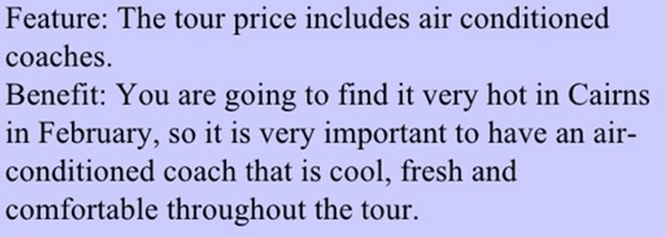
Turn Features into Benefits
You are talking to a customer in a travel agency about taking a trip to Cairns, Australia in the Month of February. You know that Australia’s summer is during that time but the customer is not
sure if they should pay for an air-conditioned bus ride during
a tour.

Slide 13
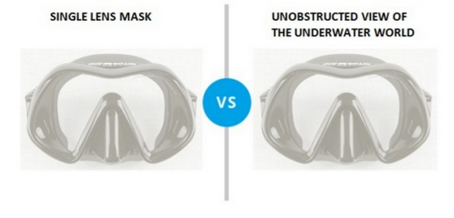
Turn Features into Benefits
A customer is buying diving goggles for a trip to the Cayman Islands. She’s looking at a single lens mask. The “what” is that it is a single lens mask. The “why” is that by purchasing the single lens mask, YOU will have an unobstructed view of the underwater world.
Feature Benefit

Slide 14
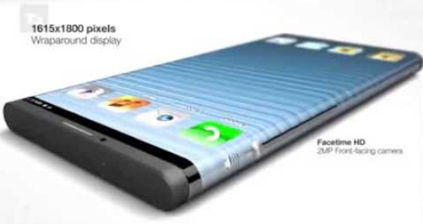
Turn Features into Benefits
Product: A new iPhone
Feature: It has facial identification
Benefit: ??? (You fill in the benefit)
Feature
Benefit ???
Feature
Benefit ???

Slide 15
Understanding Competitors’ Products & Services
Review the competition’s marketing materials (ads) and if possible,
visit them to see what they are selling and at what price. Check out
their social media sites. Learning about your competition can help you
determine their advantages and disadvantages.
Why would someone buy a product from you instead of your competition?

Slide 16
Chapter 2: Customer Service
2.3 Assess and Meet Customer Needs
Greet and engage the customer in a personal and professional manner
Listen attentively and respond effectively to customer’s comments and questions
Assess the customer’s needs while determining the customer’s knowledge of products/services to promote
customer loyalty
Identify the customer’s budget through active listening
Use customer feedback to improve customer satisfaction
Arrange service recovery and handle service failures

Slide 17
Exceptional Customer Service Means Extraordinary Business
Consumers spend up to 10% more for the same product if it comes with better service
When customers receive good service, they tell 1 to 3 people
When customers receive bad service, they tell an average of 10 people
The likelihood that customers will repurchase from a store if their complaints are handled quickly/pleasantly is 82%
When service is poor, 91% of customers refuse to go back to that store

Slide 18
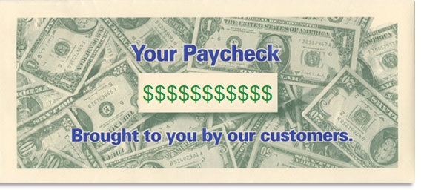
Key Point
Without customers, there is no revenue. No revenue means no wages for employees, so the customer is your paycheck.
Remember this when you need a pay raise!

Slide 19
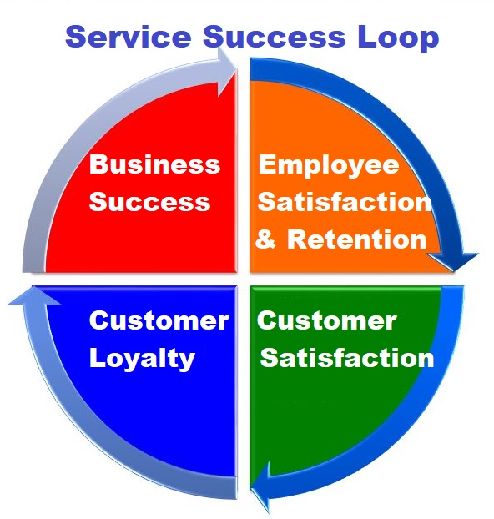
Study the Service Success Loop
With better service skills, you will be able to satisfy customers consistently
High performers tend to experience greater job satisfaction and have a higher percentage of loyal customers
Because loyal customers are the most profitable customers, having more loyal customers is the most important way to ensure a long-time business success
The service your provide to your customers is critical to the success of the organization
Successful organizations are in a good position to engage in activities that drive employee satisfaction and retention, so the cycle continues.
Customer Service is a very important strategy for operating a successful business.

Slide 20
Greeting and Engaging the Customer
Your first step in providing exception customer service is
in projecting a professional, friendly and welcoming image.
Looking professional isn’t just about how you dress. It also has to do with acting alert and courteous.
Acknowledge the customer’s presence within the first 30 seconds
First impression is hard to change, so don’t make a bad one
Make eye contact
If working with customer and a new customer walks in, excuse yourself briefly to tell the new customer you will be right with them.

Slide 21
Listen Attentively and Respond Effectively
Smile and look at people when you greet them. That shows them that you are friendly and interested in helping them.
Studies show that customers who are greeted promptly will spend more money. At the same time, customers who wait 30-40 seconds to be greeted think they have waited 3-4 minutes.

Slide 22
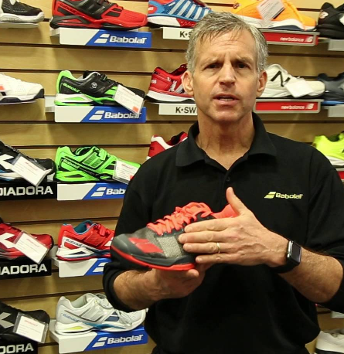
Listen Attentively and Respond Effectively
Don’t act too familiar with someone who behaves in a shy or reserved way. Don’t push the humor too far because a customer is very outgoing. This can make the customer feel uncomfortable.
One subtle approach when you see a customer looking at a particular item might be:
“That’s our top-of-the-line running shoe” (or whatever the product is)
Saying this complements the customer’s taste and assures the customer that he/she is an expert.

Slide 23
Assess the Customer’s Needs
After you’ve acknowledged the customer and are ready to begin helping the customer, you should:
Observe the customer for a few seconds to pick up on any clues to start a conversation. If the customer appears to be in a hurry, give quick, efficient service. If the customer seems to be browsing, offer service, but give him space to browse. If the customer is checking price tags, make him aware of specials/sales.
Establish a common interest with the customer. For example, if a customer tries out a product, watch for a reaction and make an appropriate comment.

Slide 24
Assess the Customer’s Needs
Another approach is to use “The Icebreaker”
The Icebreaker could be something simple you say such as:
“It’s a beautiful day.”
“I’m sure glad the rain has stopped.”
“Aren’t you just loving this weather?”

Slide 25
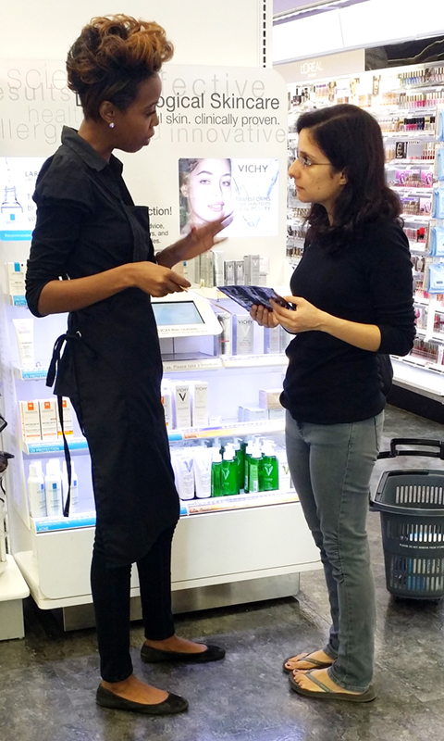
Greeting and Engaging the Customer
Three Stages to Approaching Customers:
Greeting Stage:
This presents you as a friendly, nonaggressive person. There are 2 types of greetings:
Formal: Good morning (or evening), sir or ma’am. Can I direct you to a particular product?
Informal: Hi! How are you doing today?
TIP: Combine the greeting stage with the service stage for a good approach
Service Stage:
In this stage, you offer to help satisfy the customer needs:
How may I help you?
Benefit Stage:
This approach presents you as an observant customer service representative.
This fabric washes well.
We are offering a 90-day free subscription today.
These are on sale today ONLY.

Slide 26
Assess the Customer’s Needs
Asking a question is like opening a door. You’re inviting a customer to talk. If you listen carefully, they will tell you what they need.
Ask probing questions which help you find out more about the customer’s need, problem, or complaint to help identify the solution.
Two basic types of probing questions:
Open-ended Closed-Ended

Slide 27
Assess the Customer’s Needs
Open-Ended Question-best at the beginning of a conversation with a customer. These usually begin with who, what, where, when, how and why. They cannot be answered with a simple “yes” or “no” response.
TIP: Be careful in using “why” questions, especially when working with a customer on a return or exchange. “Why” questions can sometimes sound like you are accusing or blaming the customer.

Slide 28
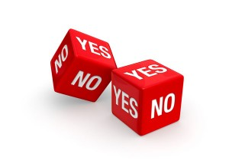
Assess the Customer’s Needs
Closed-Ended Question-tend to evoke one-work answers like “yes” or “no.”
The purpose of using closed-ended questions is to limit talking or to control the direction of the conversation. Closed-ended questions usually being with words like “do,” “will,” “can,” and “are.”

Slide 29
Assess the Customer’s Needs
Which of these are Open-Ended and which are Close-Ended?
Can I send you a sample?
Are you happy with your current vendor?
Why are you considering a change in product?
Do you want me to write up the sales ticket?
When do you expect to make a decision?

Slide 30
Assess the Customer’s Needs
Customers have 2 basic kinds of needs:
Personal needs-involve the customer’s need to be treated with respect and to feel valued, understood and involved in the decisions that affect them.
Practical needs-those needs that motivate the customer to come to you in the first place in order to solve a problem or get a product/service

Slide 31
Assess the Customer’s Needs
Customer Objections-these are a natural part of the selling process. Objections show interest and enable the salesperson to give more information to the customer. The more information the customer has, the easier it is to make the sale. So sales objections are part of the process that results in the customer getting the information he needs to decide to buy. To overcome objections, know your product.
Excuses-these are statements made by a potential customer which show that he is not ready to make the purchase

Slide 32
Assess the Customer’s Needs
Steps in Handling Customer Objections

Slide 33
Assess the Customer’s Needs
Build Customer Confidence by using these Techniques:
Let the customer speak
Demonstrate interest by maintaining a “you,” not “I” attitude
Respond with Confirmation Questions to assure the customer that you understood.
Make eye contact and listen
Only interrupt when necessary to ask a clarifying question
Get the customer’s opinion and ask clarifying questions
Respond with clear and accurate answers
Offer idea and applications for the product or alternatives (if necessary)
Counter objections politely and avoid making assumptions

Slide 34
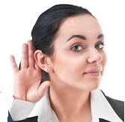
Identify the Customer’s Budget Through Active
Listening
Active Listening-listen to what is being said and also listen to what the works mean (the message behind the words).
Watch your body language (make eye contact, don’t slouch or cross your arms or turn your body away)
Let the customer speak freely. Only interrupt when necessary to ask a clarifying question.
Avoid thinking about what the customer is going to say next.
TIP: Ask CONFIRMATION QUESTIONS which will help you confirm that you have understood the customer’s message.

Slide 35
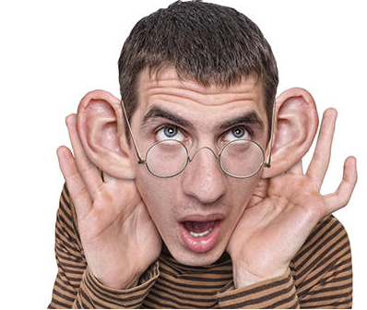
Identify the Customer’s Budget Through Active
Listening
Best Practices for Active Listening
We retain only 25% of what we hear!
During a typical day, we spend
9% of our time writing
16% reading
30% speaking, and
45% listening.
You’re missing a lot if you’re a poor listener!! Work on this.

Slide 36
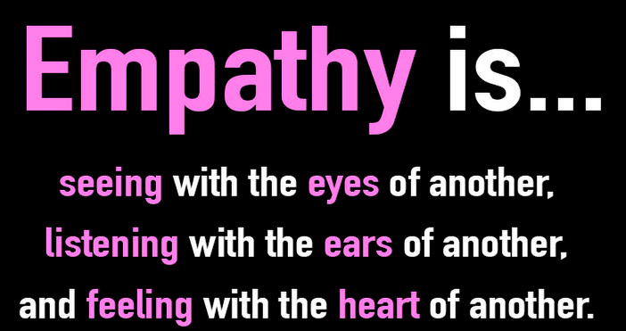
Identify the Customer’s Budget Through Active
Listening
Best Practices for Active Listening
Focus entirely on your customer and show empathy (see below)
Listen completely; don’t be thinking about what you’re going to say next
Listen for what is NOT said; watch for non-verbal signals and again show empathy
Remain objective; do not judge
Empathy-to experience the feelings, thoughts, or attitudes of another (customer). In other words, try to put yourself in the customer’s shoes to try to understand them.

Slide 37
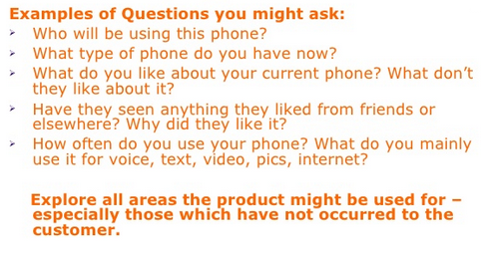
Techniques to Address Customer Needs
Your customer is looking at cell phones. Here’s some examples of what you might say:

Slide 38
Techniques to Address Customer Needs
Questions NOT to Ask
“How much do you want to spend?”
This question sets limits and puts a customer on the defensive.
“Do you want __ or __?”
Asking this type of question too early in your sales presentation will narrow the customer’s choices before all options have been examined. You also will be narrowing the chance that the customer will make the purchase. You can ask this type of question when you feel that all options have been examined.
“Why do you want __?”
This question is asking the customer his motive in buying this product; it can put the customer in a defensive mode. It’s like saying, “why in the world would you buy that.”

Slide 39
Techniques to Address Customer Needs
In Store, on the Phone and Online
While waiting on a customer, the phone rings. What do you do?
You must find a balance between serving the customer in front of you and the one on the phone. To do this, you would:
Excuse yourself to answer the phone.
Answer politely and professionally.
Determine why the customer is calling.
If the caller will need a great deal of your time, ask permission to put the customer on hold OR tell them you are with a customer, get their number and say you call them back.
Get back to your in-store customer, then as soon as possible get back to the caller.
Be prompt and accurate. Don’t make promises you can’t keep, and keep the promises you make.

Slide 40
Techniques to Address Customer Needs
Welcoming Phone Etiquette
When answering the phone at your business, do the following:
Speak as if you are smiling; show expression and feeling in how you speak (this is called tone)
Give the name of your business, your name and then an opening statement.
Sound enthusiastic and ready to help.
Example: “Good morning and thank you for calling Belk. My name is Ashley. How can I help you today?”

Slide 41
Techniques to Address Customer Needs
Welcoming
Phone Etiquette
Make your customer
feel valued and
important.

Slide 42
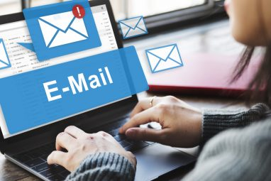
Techniques to Address Customer Needs
Addressing Customers Online-Email Etiquette
Use proper grammar and spelling
Begin with a personal salutation, such as Dear Mr. Bowman or Dear Fellow Golfer.
Make messages short and visually interesting
Pretend you are writing to your English teacher
Put the most important items first
Write clearly and specifically
Use action verbs
Read the message out loud to hear how it sounds
Keep the shortcut lingo (ex.-LOL) for your friends
Proofread-a lack of proper capitalization and punctuation has been proven to slow reading down and cause confusion for customers

Slide 43
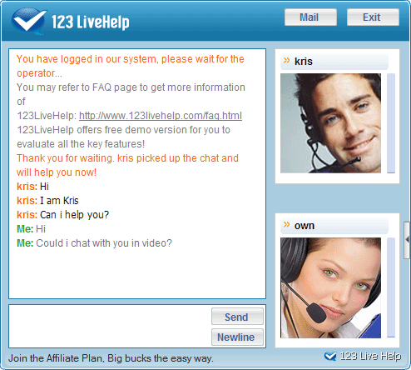
Techniques to Address Customer Needs
Addressing Customers Online-Live Chatting
A “live chat” occurs online when a customer is on a web site and has questions. If the “live chat” option is available, the customer can initiate it and a salesperson will start chatting.
As the salesperson in a live chat, follow the same rules as for email.
Listen and wait-some customers will give you the whole story; others may write one sentence and wait for you to respond so be patient.
Be prompt-if your response will take some time, let the customer know. Check in with the customer if it takes even longer.
Proofread to avoid miscommunication.

Slide 44
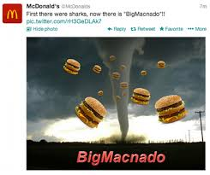
Techniques to Address Customer Needs
Addressing Customers Online-Twitter
Over 30% of top brands have their own Twitter handles. Those who use Twitter love the instant gratification of social media.
Tweeting can be a great tool when used properly. It is limited by the fact that you can only use 280 characters, so there will be no in-depth conversation.
Treat tweeting on behalf of a business in the same way as you would treat emails.

Slide 45
Techniques to Address Customer Needs
Meeting Customer Needs and Providing Exceptional Service
There’s giving Customer Service and then there’s giving Exemplary Customer Service. Following is a list of customer’s most important wants and needs when it comes to exceptional Customer Service.
1. Problem Solved 6. Consistency, Reliability and Predictability 2. Effort 7. Value
3. Acknowledgement & Understanding 8. Reasonable Simplicity their Expectations 9. Prompt Service
4. Choices and Options 10. Confidentiality
5. Positive Surprises

Slide 46
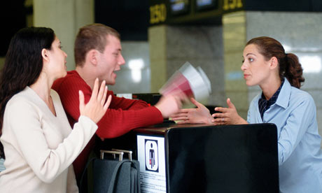
Arranging Service Recovery & Handling Service Failures
Grievance-a wrong considered as grounds for complaint, or something believed to cause distress
The Customer 4-Step Grievance Process
These steps require you to use your customer service and questioning techniques to gain a clear understanding of the customer’s needs and want.
Step 1: Keep your composure
Step 2: Apologize and thank the customer
Step 3: Listen carefully and investigate the situation
Step 4: Propose solution options.
Customer Complaints give a business valuable feedback about things they can fix and avoid those problems in the future.

Slide 47
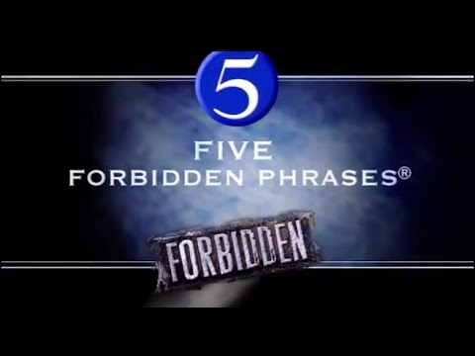
Arranging Service Recovery & Handling Service Failures
5 Forbidden Phrases to Use When Handing Customers with Problems
1-“I don’t know”
INSTEAD: Say something like, “That’s a good question; let me find out for you.”
2-“We can’t do that”
INSTEAD: Say something like, “Here’s what we do can,” or “Here’s how we can help,” or “Here’s what needs to be done,” or “I need to.” Give options using the words “we” or “I.”
3-“You have to…”
INSTEAD: Telling a customer that they have to do something might incite them even more. Explain what you can do for them. Once you do that, you can then given them instructions on what they may need to do.

Slide 48
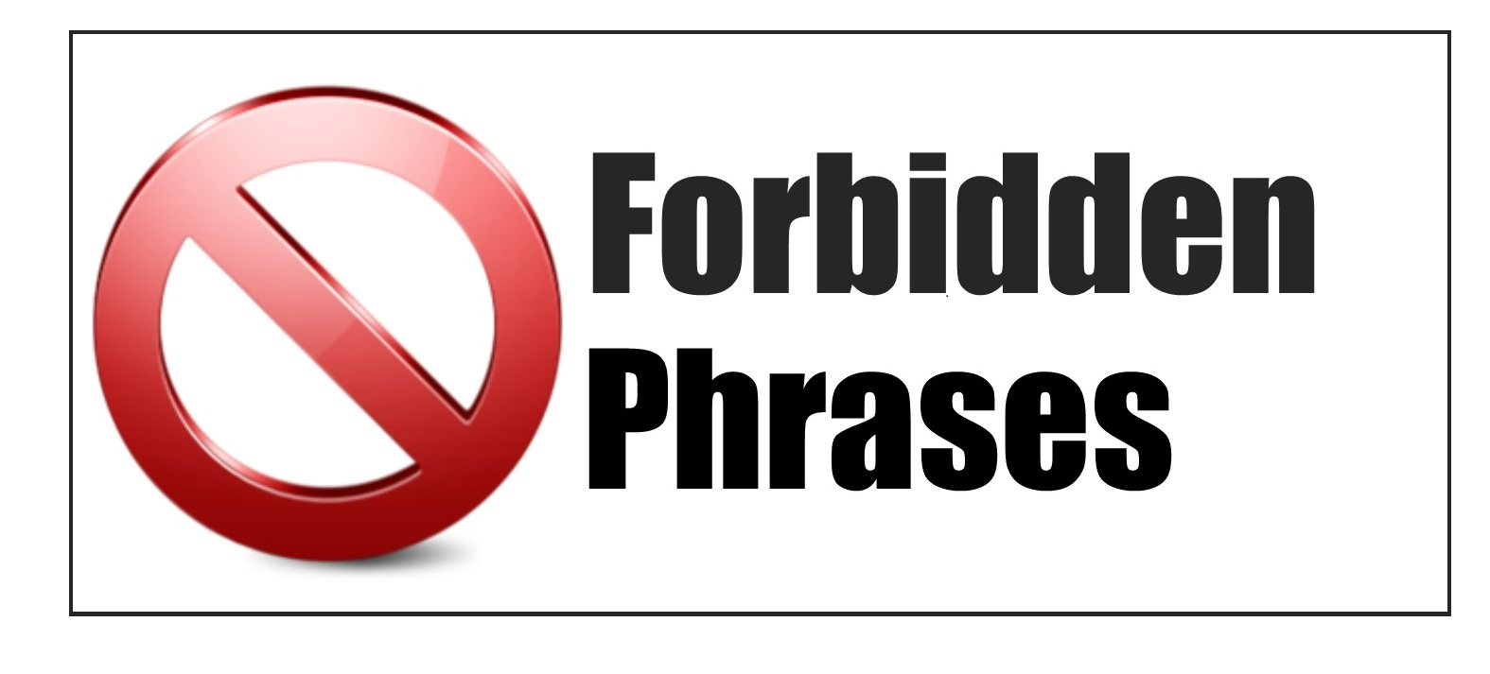
Arranging Service Recovery & Handling Service Failures
5 Forbidden Phrases to Use When Handing Customers with Problems
4-“Just a second”
INSTEAD: Give an honest answer about how long it will take you to complete whatever you are doing and tell them what you are about to do.
5-“No”
INSTEAD: Try to find a way to state the situation positively. The customer is not always right, but he is always the customer and they hate to hear NO. You may not be able to do everything they want, but be assure to tell them what you can do.

Slide 49
Chapter 2: Customer Service
2.4 Educate the Customer
Explain levels of product/service value to customers in a way that is relevant to their needs
Recommend comprehensive solutions, products, services, and related items based on customer needs
Educate the customer about service policies and related resources (e.g. returns, warranties, guarantees, service plans, support plans, instruction)
Know when to ask for help, support, and advice

Slide 50
Explain Levels of Product/Service Value to Customers in a Way that is Relevant to their Needs
As you being your customer interaction, you will want to make sure that you understand why the customer has come into your store. They may or may not know exactly what they want. Your job is to provide guidance.

Slide 51
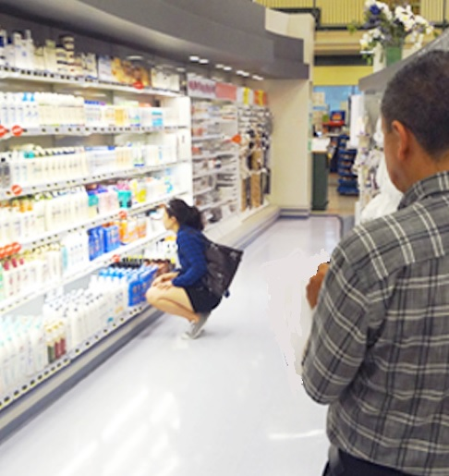
Explain Levels of Product/Service Value to Customers in a Way That is Relevant to their Needs
Before you can explain anything to a customer, you must first
meet them. What’s your Opening Statement?
“May I help you?”
“Can I help you find something?”
Although these are often used, you already know what
the customer will say in response. It’s better to observe
the customer for a short period of time and open with a
question or comment about the product at which they
are looking.

Slide 52
Energizing Your Presentation
Once you’ve given your Opening Statement, it’s time to really start a conversation with the customer to find out his/her needs.
Here are 4 steps to use to “energize” your customer interaction:
Share a personal story-tell the customer about your personal experience with the product/service. This gives you credibility with the customer.
Ask questions-Find out what specific features the customer is interested in.
Discuss benefits-talk about why this is a good product/service; turn the features of the product into benefits that the customer will understand. Benefits tell the customer how it solves a problem or makes life better.
Demonstrate the produce-show the customer how to the product works.

Slide 53
Energizing Your Presentation
Reviewing-Features of a Product versus Benefits
Feature Selling
When you "sell a feature," you describe some element of your offering, in the hope that the customer will be suitably impressed. Feature selling is generally ineffective because customers usually can't figure out why a particular feature or function is meaningful to them.
Benefit Selling
When you "sell a benefit," you are still essentially describing a product feature–but you tie it to some way that it improves the customer's situation solve his problem or makes his life easier.

Slide 54
Energizing Your Presentation

Slide 55
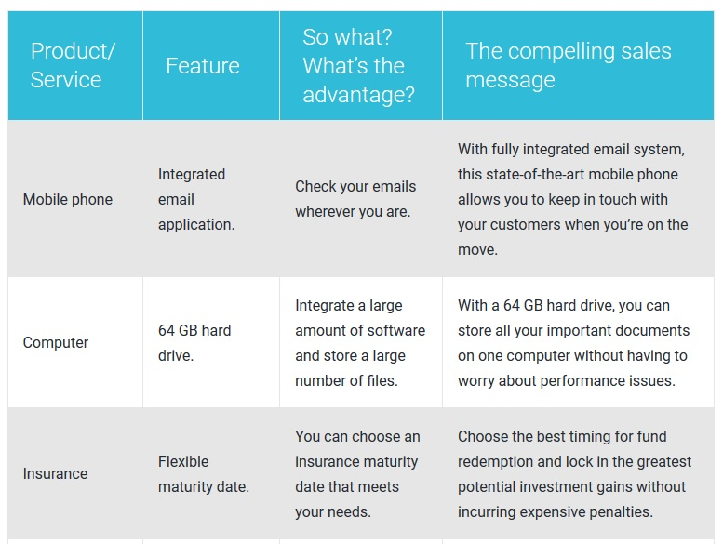
Energizing Your Presentation
The Benefit

Slide 56
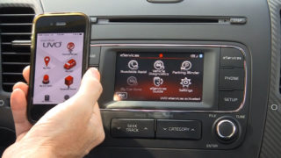
Energizing Your Presentation
Demonstrating the Product/Service
If possible, get your customer involved in the demonstration.
Make sure the product works before demonstrating it.
Show the features and explain how they will benefit the customer.
You are selling cars and want to demonstrate to the customer how to connect their cell phone to the blue tooth technology to pay music, answer their phone, etc. Demonstrate to the customer how to “pair” the 2 devices.
Demonstrations should be personalized, simple and don’t forget to ask the customer questions to make sure they understand the product’s operation.

Slide 57
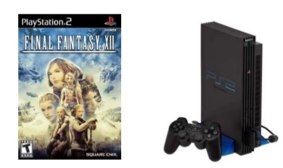
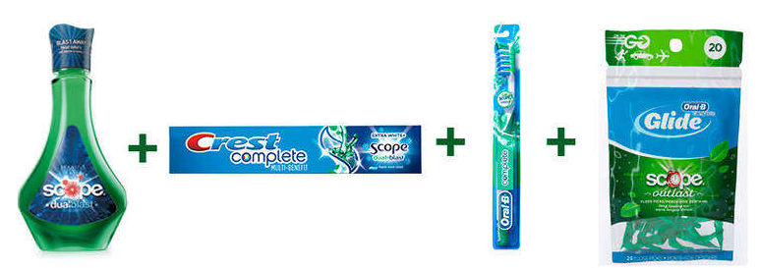
Cross-Selling & Proposing Customer-Specific
Solutions
A complete solution to your customer’s needs includes the following:
Complementary Products-products that often go with another product. For example: selling men’s slacks so a complementary product would be dress shoes

Slide 58
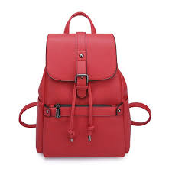
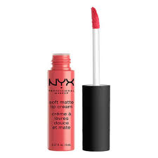
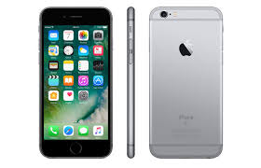
Cross-Selling & Proposing Customer-Specific
Solutions
A complete solution to your customer’s needs includes the following:
Suggestive Selling-what you say to a customer to get them to buy a complementary product. McDonald’s is famous for “Do you want fries with that?” That’s suggestive selling. You are trying to increase the final amount of the sale. What would you suggest for each of these products?

Slide 59
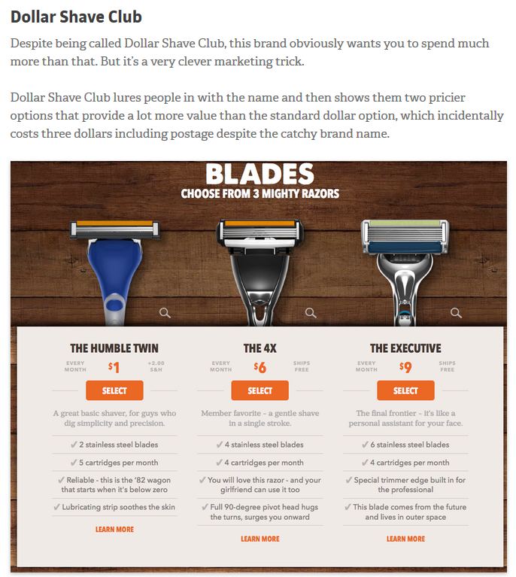
Cross-Selling & Proposing Customer-Specific
Solutions
Upselling-providing the customer with
higher quality and possibly more
expensive versions of what he/she
has already looked at. Don’t think of
“upselling” as a way to improve your
sales numbers. Think of it as a way to
improve your customer’s satisfaction
with their purchase.

Slide 60
Cross-Selling & Proposing Customer-Specific
Solutions
Suggesting Alternatives-if you are out of stock of an item a customer is interested in, do the following:
Double-check the stock room.
If there are none, check to see when the next shipment comes in.
If your store has multiple locations, check the other stores to see if they can transfer the item to you or ask if the customer can pick it up.
If the item is in your warehouse, find out when it can be sent to your store or delivered to your customer.
Suggest a similar item (an alternative suggestion) that will meet the customer’s needs like the item originally wanted.
Offer the customer a “rain-check” if the item is on sale. A “rain-check” is usually issued when an item is NOT on sale and advertised as “limited quantities” or “while supplies last.”
If all of the above don’t work, sent the customer to one of your competitors which carries the item.

Slide 61
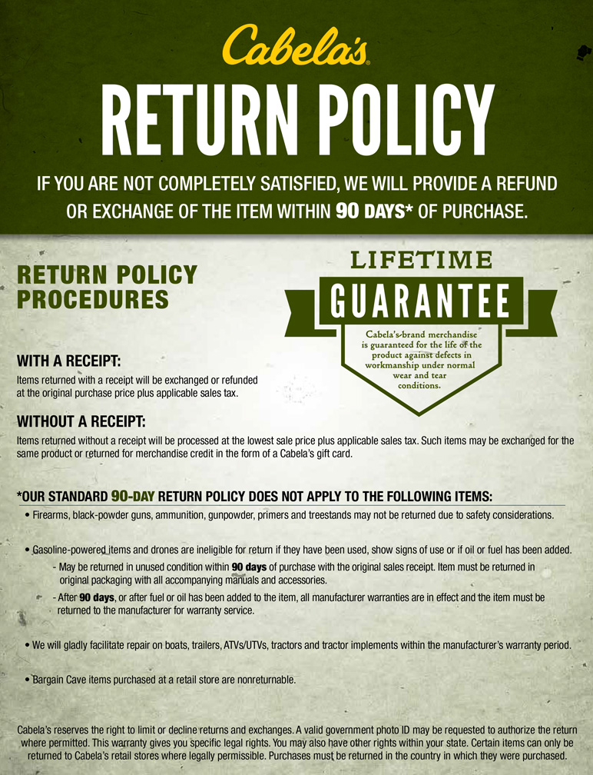
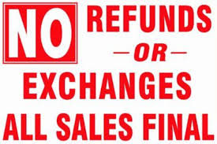
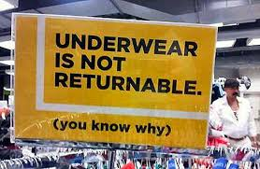
Cross-Selling & Proposing Customer-Specific
Solutions
Return Policy-how long does a customer have to use the product and
return it if not satisfied. The return policy may be posted and sometimes it is on the customer’s receipt. Sometimes the
company policy states exceptions to the return
policy. Explain the policy and any excepts to the
customer. Always follow your store policy.

Slide 62
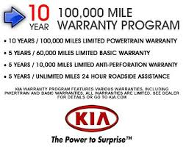
Cross-Selling & Proposing Customer-Specific
Solutions
Warranties-given by the manufacturer
A warranty is a legally binding assurance that a product or service is, among other things, (1) fit for use as it was described, (2) free from defective material and workmanship, (3) meets laws and/or other specifications. A warranty describes the conditions under, and period during, which the producer or vendor will repair, replace, or other compensate for, the defective item without cost to the buyer or user. Often it also lists the rights and obligations of both the buyer and the seller in case of a claim or dispute.

Slide 63
Cross-Selling & Proposing Customer-Specific
Solutions
Guarantees-A guarantee outlines what will happen should the buyer not be satisfied with his purchase. It usually is a promise to repay the customer if he is not satisfied, but it may have some limitations. In the 1st graphic below, the limitation is “less shipping and handling costs.”

Slide 64
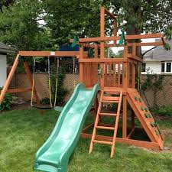
Cross-Selling & Proposing Customer-Specific
Solutions
Deliveries and Home Assembly-when a purchase needs to be delivered to the home of the purchaser or when it needs to be assembled at the home of the purchaser, the sales associate should explain exactly what this will cost (if any cost) and when it will happen. Set up the date of delivery or home assembly but make sure your can commit to the date promised. Write down all of the contact information and double-check it.

Slide 65
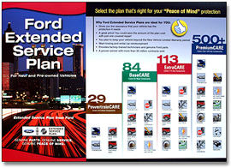
Cross-Selling & Proposing Customer-Specific
Solutions
Extended Warranties and Service Plans-these require the sales associate to do some additional selling. The selling of these plans should be done just before closing the sale.
These extensions are like insurance policies. For example, a one-year warranty by the manufacturer might be extended for a second year. A 2-year service plan might be extended another year. These extensions come with an additional cost.

Slide 66
Knowing When to Ask for Help, Support and Advice
Difficult Customers-if you run into a difficult customer and you find that you can’t handle the situation, you should as for help from your supervisor or other team members.
Team meetings are a great place to find out about new products/services coming to your store. They are also the time to ask for help with store policies, customer concerns and anything else related to selling products.

