Slide 1
Chapter 4
Selling and Service

Slide 2
Chapter 4: Selling and Service
4.1 Prepare for Selling
Identify the needs and characteristics of customers within the target market and customize sales approach accordingly
Serve as an expert regarding relevant company and industry pricing strategies, company policy, regulatory compliance, product knowledge and company services
Support the development and execution of strategies for selling products and/or services Remain knowledgeable of sales goals, their implications and how they are based on current and past performance

Slide 3
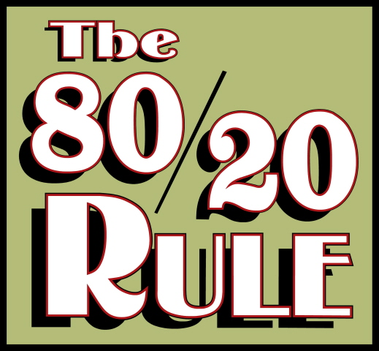
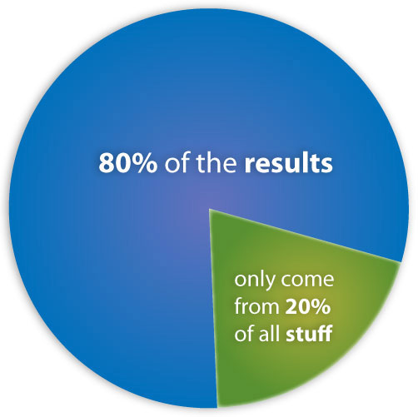
Identifying and Prioritizing Potential Customers
Retailers realize that their customers differ in their profitability in that a small number of customers account for the majority of their profits. This is the 80/20 Rule.
and are loyal

Slide 4
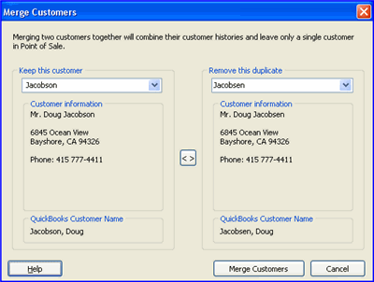
Customer Records
To succeed in offering great personal service to customers, you will learn to rely on maintaining a record of needs, preferences and other information that your customers are willing to share with you.
Your Customer Records could be digitally recorded but could also be kept in a notebook or binder.
Some retailers have an electronic Customer Relationship
Management program to track customers. Keep your
records up to date and deliver to customers your best
personalized assistance.

Slide 5
Customer Records
Keep records on anyone who comes into you store—whether they buy or not. Make a note about any requests they make. Keep track of any follow-up you do with the customer and make note of any responses you receive. Be sure to keep your customer records private.
Your records should include the following for each customer:
Name
Email address
Shipping/delivery address
Telephone number(s)
Occupation/hobbies, collections, activities, projects, etc.
Purchases made
Preferences or specifications (sizes, brands, types, colors, styles, allergies
Other considerations like having products delivered, assembled serviced

Slide 6
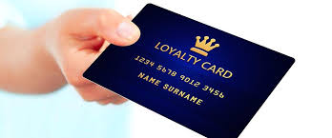
Loyalty Programs
Many retailers and service providers offer loyalty programs. These programs utilize data obtained from a customer’s previous purchases as well as any info put in by the sales associate. Those who offer “Loyalty Programs” usually give their customers a special card or account number.
Loyalty Program Examples:
Buy 10 sandwiches, get your 11th free
Spend $100 and get $20 in rewards on your next purchase

Slide 7
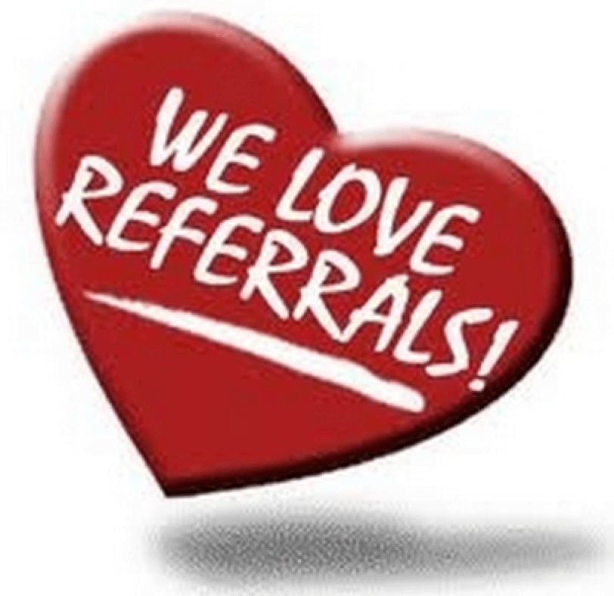
Referrals
A “referral” is when a person recommends a store or sales person to someone else based on his/her experience.
If you are serious about building your clientele, you should ask for referrals. A simple, effective way to ask for referrals that doesn’t sound push or rude is:
“If you’ve been happy with the service I’ve provided and know someone who could benefit, have them give me a call.”
You should thank the person who sends you a referral no matter if the referral makes a purchase or not. Give the person making a referral a call to thank them or send them a “thank you” note. If a person continues to send referrals, consider giving them something more, such as a discount on a future purchase or a gift card.

Slide 8
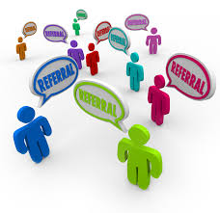
Referrals
Keep in mind that “word of mouth” recommendations are the best means of advertising.
Caterers, hairstylists, consultants, trainers, architects, contractors, electricians, plumbers, and carpenters all rely on referrals to stay in business. The more referrals you receive, the more business you will get!

Slide 9
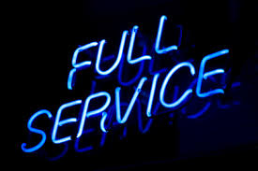
Identifying and Priortizing Potential Customers
Unique Selling Propositions-what is it that makes you and your company different from other retailers? Is it fast service, great customer care, personal service, or what?
Selling and Service Models-The 2 main models of selling and service are:
Self-Service-customers expect limited interaction with a sales associate
Relationship Building-customers expect to interact with a sales associate and expect to receive recommendations, information and answers to questions.
What type of model do you think of when you go to these stores?
Walmart
CarMax
Chili’s Restaurant
Men’s Warehouse

Slide 10
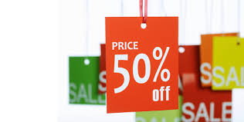
Advertising & Promotions
Promotion-anything that includes personal selling, publicity or activities that cause customers to want to make a purchase. These activities could include contests, social medial, giveaways, coupons, events, promotional gifts, referral incentive programs, rebates and so on.
Advertising-the vehicle which a retailer uses to get the message to the customer about a promotion. Advertising can be done in print (newspapers, magazines, flyers, billboards, social media, etc.) or can be broadcast (TV, radio, etc.)
Ads are used to promote the latest trends, a new product, sale merchandise and clearance items.

Slide 11
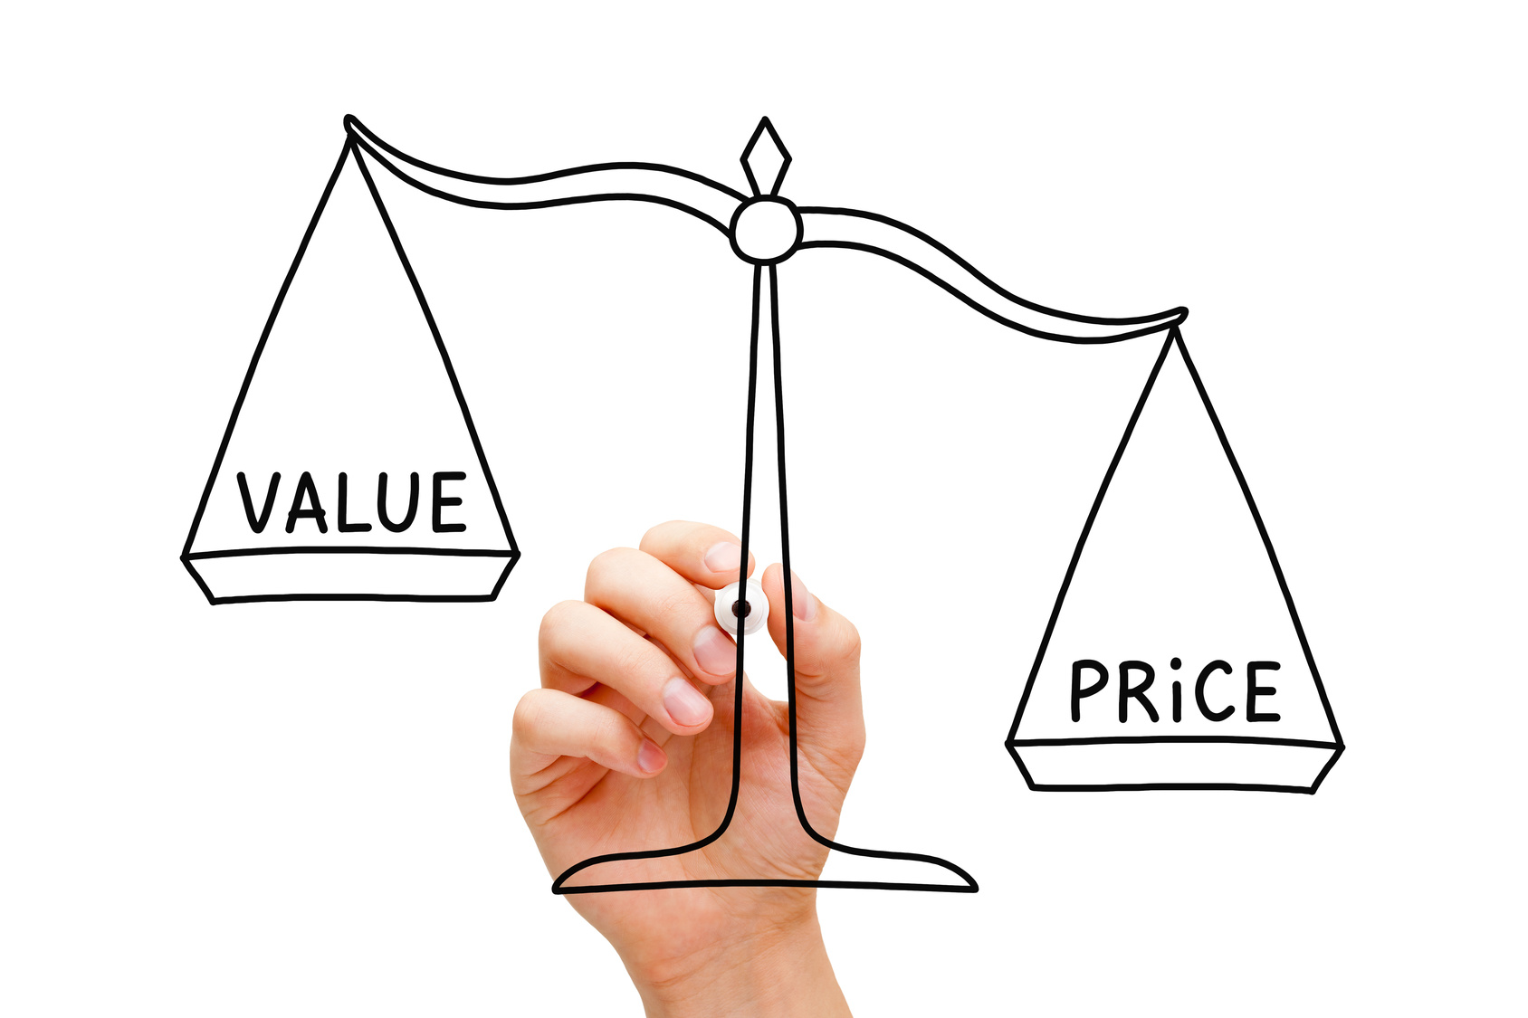
Understanding Pricing Strategies and Policies
Price Sensitivity-the price that the customer is willing to pay for the product or service based on what benefit the purchase will give them.
Retailers must take into account:
At what price would a customer find this item too expensive?
At what price would a customer find this item priced so low that it’s probably not good quality?

Slide 12
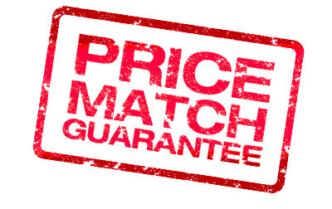
Understanding Pricing Strategies and Policies
Price Matching-this will help assure customers that they will get the best price and means that if the customer finds the same item priced lower somewhere else, you will give the customer that price at your store.
Caution: Price Matching does not necessarily apply to a brick-and-mortar store price and an online price. Remember that online pricing is probably lower because they do not have to pay many overhead expenses.

Slide 13
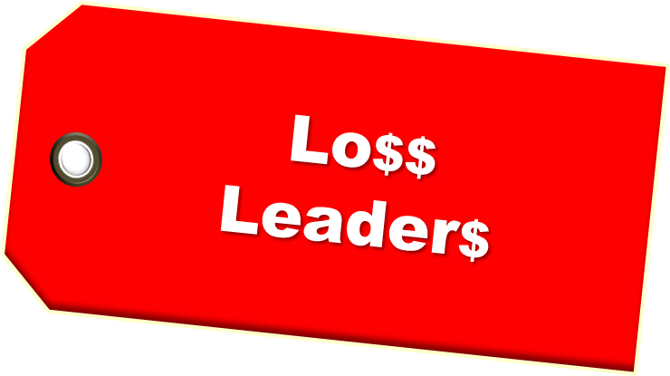
Understanding Pricing Strategies and Policies
Psychological Pricing-techniques that help create an illusion for customers. Examples are:
Odd and Even Pricing-setting all prices in either an odd or even number. Using odd numbers ($.79, $9.95, $699) you convey a feeling of a bargain. Using even numbers ($10, $50, $100) you convey a feeling of quality.
Loss-Leader Pricing-used to increase store traffic by offering a very popular item for a sale at below-cost pricing.
Example: Winn Dixie purchases dozens of eggs from a farmer at $.89/dozen. They normally sell them to customers at $1.49/dozen, but they want to use eggs as a loss leader to get customers in the store, so they sell them at $.79/dozen.

Slide 14
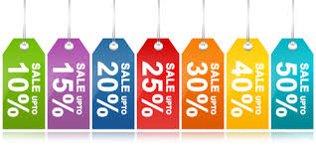
Understanding Pricing Strategies and Policies
Calculate the Discount-a good sales associate should be able to calculate a discount in their head or at least using a calculator. A simple method to figure a discount is
Step 1: Subtract the discount from 100%
Step 2: Convert the percentage to a decimal
Step 3: Multiply the original price by the decimal amount (round to nearest penny)
Example: All books are 30% off. A customer wants a book that is originally priced at $19.95.
Step 1: 100% - 30% = 70%
Step 2: 70% becomes .70 (move decimal place 2 places to left)
Step 3: $19.95 X .70 = $13.965 which would round to $13.97 (the amount the customer would pay

Slide 15
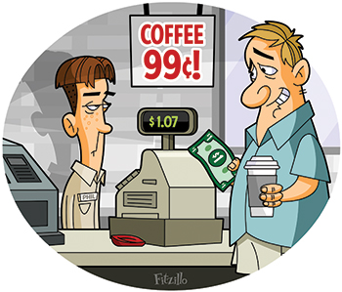
Understanding Pricing Strategies and Policies
Sales Tax-almost every state and local government impose a sales tax on purchases. These can range from a low of 2.9% to a high of 11%.
Example:
Your state might impose a sales tax of 5%.
Your city might impose a sales tax of 4%.
This means you must pay a total of 9% in sales taxes on your purchase.
Purchase a car for $10,000 and the sales taxes would be $900 ($10,000 X 9%). This means you would need to pay $10,900 for the car.

Slide 16
Chapter 4: Selling and Service
4.2 Gain Customer Commitment and Close the Sale
Listen and/or observe customers for verbal or nonverbal cues indicating purchase intent
Discuss the specifics of the sale (e.g. deliver and/or installation date, financing, warranties and product protection plan
Identify and suggest additional products and services to the customer that complement the sale
Confirm sale information with the customer
Complete sales transaction with the customer

Slide 17
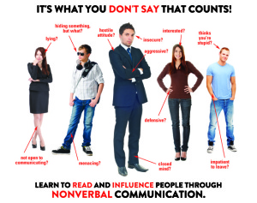
Observing Customers for Buying Cues
A good salespersons pays attention to customers to determine when they are ready to make a purchase.
Verbal Clues-listen for statements such as “I’ll take this one,” or something more subtle like, “I really like the red one.”
Non-Verbal Clues-body language doesn’t lie, so if you become good at recognizing a person’s body language, you will be good at closing the sale.

Slide 18
Identifying and Suggesting Additional Products and Services
It is the sales associate’s responsibility to complete the sale by giving your customers the chance to make their purchase AND buy any additional items that might “accessorize” their purchase.
Sales Process in Action
Step 1: Recognize Buying Cues
Step 2: Offer Assistance
Step 3: Suggest an Additional Product/Service to Complement the Sale
Step 4: Close the Sale

Slide 19
Identifying and Suggesting Additional Products and Services
Once the sale has been made, it is your job to go over the
Warranty
Extended service plan
Delivery and/or installation, and the
Return or exchange policy

Slide 20
Tips for Ringing Up a Sale Accurately
Attention to detail is very important when ringing up a sale.
Be sure to enter item numbers or SKUs. This helps keep track of inventory levels.
Make sure you are entering the right quantity.
Enter prices carefully putting the decimal in the right place.
Be careful about entering any personal information which could compromise a customer’s privacy such as account numbers or credit card numbers.
Make sure you subtract when you credit a customer with a return and add when you are processing a purchase.
Don’t forget to add sales taxes or delivery/installation fees.
Always remember to give the customer their receipt (in their hand or in the bag)

Slide 21
Chapter 4: Selling and Service
4.3 Develop and Implement a Sales Follow Up Plan
Follow up with customers regarding suggestions for future purchases
Suggest alternative products/services in lieu of return.
Evaluate the effectiveness of sales and marketing strategies and take appropriate action
Evaluate the effectiveness of merchandising plans and take appropriate action

Slide 22
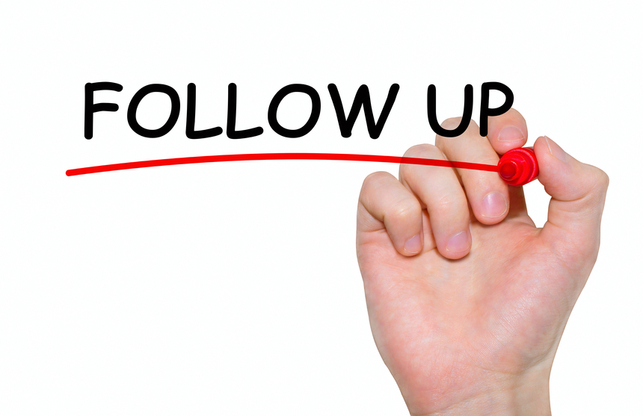
Follow Up With Customers
When following up on a sale, the sales associate will want to accomplish at least one of the following:
Ensure that the customer is enjoying their purchase
Solve any problems that the customer is having
Build a relationship
Identify future purchase opportunities
Alert the customer of upcoming promotions or new product lines
Gain referrals
Thank them for their business

Slide 23
Follow Up With Customers
When to Follow Up-not every purchase requires a follow-up. Certain types of purchases (appliances, furniture, technology) require a follow up. If delivery and/or installation were requested, this would require a follow-up.
Phone Etiquette-keep in mind the time of day that you call to follow up. Some customers might feel an interruption if you call during dinner time.
Give the customer your business card when you introduce yourself. That way you can tell them to call you if they have any follow-up questions.

