Slide 1
Louisiana DECA and
New Orleans Pelicans
Sports & Entertainment Marketing Minute Competition

Slide 2
NBA Games are full of excitement, not only because of the teams playing but because of the unending activities that go on during every time-out, break, commercial or halftime.
The activities that one sees during these “breaks” are all marketing related. They promote the Pelican’s brand, involve customers (fans) and involve sponsors.
Generally speaking, these involve short sports or entertainment-type activities/games and take about 1 minute to conduct. We call them “Marketing Minutes.”
To get a better idea of what these are, watch the following videos. When you finish the first, click to go to the 2nd, then to the 3rd.

Slide 3
For additional sample videos showing a Marketing Minute, visit www.atgfreshstart.com/MERA and click on an additional sample video at the bottom of the screen

Slide 4
Rules for Finalists Giving the Presentation at the Conference
Create a team of 1-3 people from your class/DECA chapter
Make sure that each person is involved in the activity
Get creative; think “outside the box.”
Develop an in-game sporting entertainment event for an NBA game
Imagine that your activity will be conducted during a Pelicans games sometime during this season
You might want to tie it to a particular holiday during the year or a particular game, but this is not mandatory
The activity should last only 1 minute (with a little extra time to set it up and take it down)
Plan your activity to run during either pre-game, a time-out break, a quarter break, a commercial break, or at half-time break
The activity will be conducted either on the basketball court or in the seating area
Think of a competition or an activity that uses a person, a group, the audience, some outside entertainment person/group
Your activity must be “family-oriented” meaning it cannot have anything that might be offensive to anyone in a family
Have your activity sponsored by one of the Pelican’s sponsorship partners (Click here to look on their website)
Have an MC to explain what is involved in the activity to the audience and tell who the sponsor is and what the prizes are that will be awarded.
NOTE: If you need additional people to “play” your activity, these are usually selected by the Pelicans prior to the game. For your activity, you can just use other students from your school or pick random students at the conference.

Slide 5
Tips for the Conference Presentation
Practice your activity at school many times to make sure it works like you planned it
Practice setting up the activity and taking it down so that it goes quickly and smoothly
Bring all components you will need with you to the Conference if your team is a finalist
Keep in mind as you plan your activity that there are no walls to hang anything on—you’ll be on the basketball court
If you need music, bring what you need (and have it work by battery as there is no place to plug in)
Make sure you follow the NBA rules for being on the basketball court—these are listed below
Speak slowly, clearly and distinctly into the microphone if you present to the Conference audience.
Below are some basic NBA guidelines you must follow when using the court for activities:
Please refrain from using anything that involves the use of any liquid, moist, sticky or similar substance that could adversely affect the playing surface.
Anyone who steps foot on the court must have proper footwear on (including non-marking souls.) No heels or flip-flops please.
Any props used on the court may not damage the court in any way including leaving scuff marks, scrapping the finish off of the court, etc.
Any heavy items must have non-marking wheels on them that allow for easy access on and off of the court.
Every event that takes place on the court must follow proper safety guidelines.
Groups should bring helmets, knee/elbow pads and any additional safety gear when applicable.

Slide 6
Rules for Judging Prior to Conference
Create a PowerPoint of no more than 12 slides to show what is involved in your activity
Slide #1 must be a title slide and should include your school name, your advisor’s name, and the names of the 1-3 team members.
Slide #2 should show your sponsor for the event and the prize that goes to the winner(s)
Slide #3 should be a budget in which you explain the expenses of putting on your event. The sponsor’s prizes are paid by the sponsor so they are not part of your budget; however, you can list the value of any prizes on this slide.
Slide #4-12 (can be less than 12) should show the activity. They should tell the story of what you want to do.
Submit your PowerPoint to your DECA Advisor. The DECA Advisor can select up to 2 Marketing Minute projects from his/her chapter for competition, so the DECA Advisor should pick what he/she thinks is the best one or two. The DECA Advisor will give you a due date to upload & turn in your project. Your advisor should request the Dropbox link to share your team’s PowerPoint.
If your team is selected by your DECA Advisor, fix any problems he/she found, then submit your PowerPoint to the Louisiana DECA State Association Advisor by the due date given.
A team of business-people will meet to judge all PowerPoints from various schools and pick the best 3-5 teams. These will be the finalists and will be notified a few days before the Conference.

Slide 7
Tips/Suggestions for the Creating the Presentation for Judging
If you film with a phone, speak loudly as it is hard to hear from a distance. If you have some type of microphone you can use, please do so.
Take photos of your presentation when you practiced and use them in your PowerPoint; however, you might be able to use photos or clip-art or drawing you find online.
You can type in a text box what is happening on your slide; however, if you use a voice-over and narrate what is going on, do not read what is typed.
Put some movement into your graphics.
Use a slide transition between each slide
Use voice-overs on slide
Use some music, if its appropriate
Insert a video, if its appropriate
Have your slides moves to the next one automatically. Just make sure there is time to see and read everything on each slide before it moves on

Slide 8
REWARDS TO THE FINALISTS
Top 3-5 Teams (finalists) will present to Pelicans officials and Conference Group on day of Conference
1st , 2nd and 3rd place will receive DECA medals for their efforts for each team member.
All team finalists get to go to tunnel outside of locker room to high-5 team players as they come back out after halftime or will be given some other Pelican game night activity.
First place 1-3 team members and their advisor will receive Pelican prizes (goody-bag)
First place 1-3 team members and their advisor each will receive a $50 check.
(Pelican prizes are subject to availability)

Slide 9
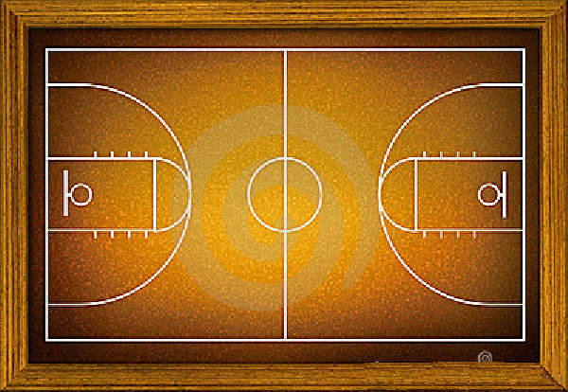
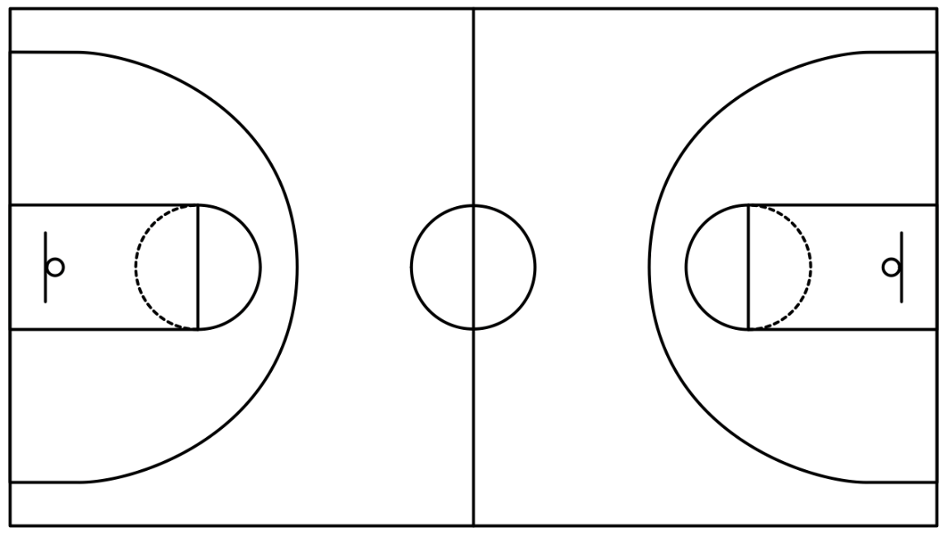
Graphics You Might
Want to Use in
Your Presentations

Slide 10
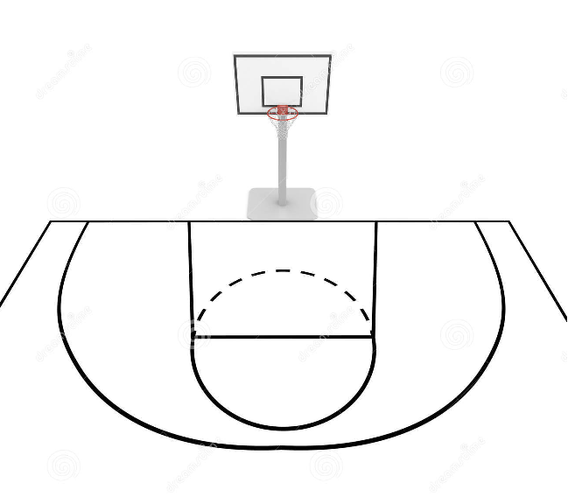
Graphics You Might
Want to Use in
Your Presentations

