Slide 1
Chapter 1
Retail Industry Overview

Slide 2
Chapter 1: Retail Industry Overview
1.1 Define Retail
Define retail and recognize the distribution channel
Distinguish between the various retail formats
Recognize the different types of ownership
Understand multichannel retailing

Slide 3
What is retailing?
Retail-a business that sells products and/or services
to consumers
Retailing-the method by which consumers acquire
products and services

Slide 4
The Distribution Channel
How does a product get from the manufacturer to the
Consumer?
Answer: Through a distribution channel
A distribution channel provides the links which enable a product or service to flow from the manufacturer to the customer. A
Common distribution channel is shown below:

Slide 5
The Distribution Channel
A manufacturer produces
the products.

Slide 6
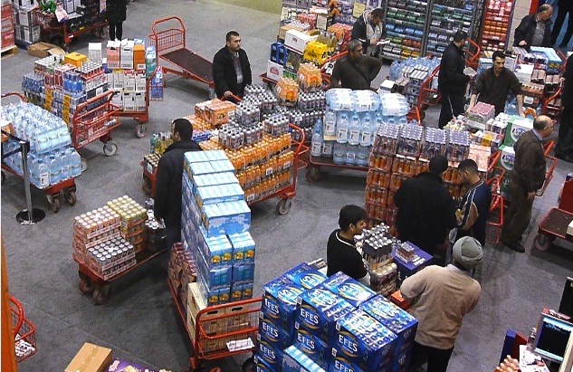
The Distribution Channel
A wholesaler buys large quantities
directly from the manufacturer, breaks them into smaller units and
sells the smaller units of products to retailers.
In the photo, retail store “buyers” shop at a wholesale store
to buy smaller units of products to sell in their store.

Slide 7
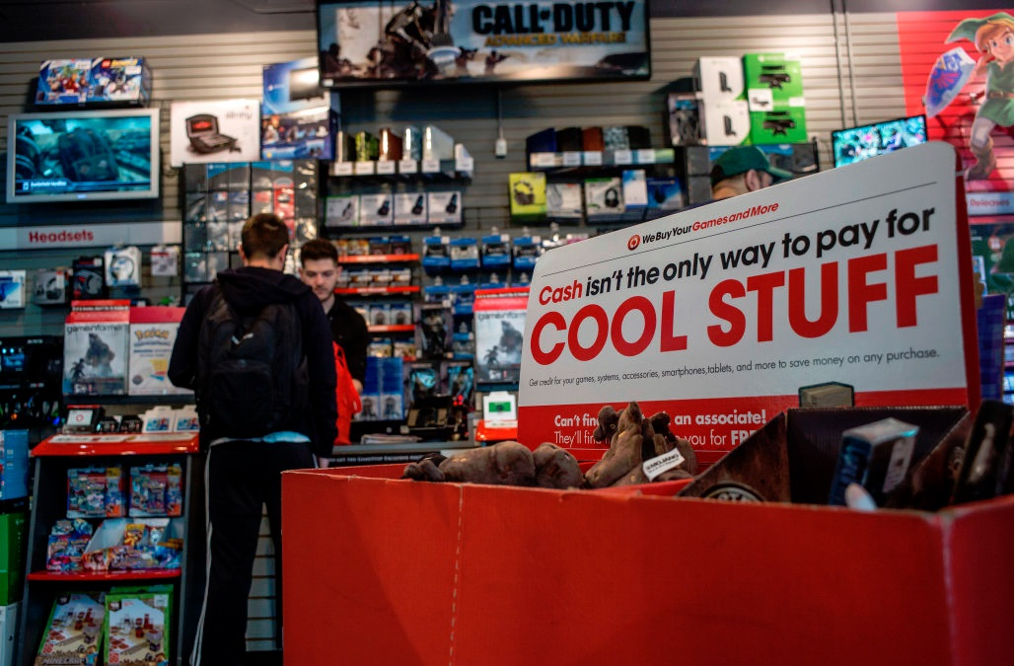
The Distribution Channel
A retailer receives, stores (in
inventory), displays and sells the products to customers.

Slide 8
The Distribution Channel
Why are distribution channels important to a customer?

Slide 9
The Distribution Channel
Why are distribution channels important to a customer?
When you need a loaf of bread, would you rather buy 1 loaf or
bake it yourself?
If you want a new dress, would you rather go buy the supplies
and size, cut and sew your own or would you rather look at a
variety of styles and pick one?

Slide 10
The Distribution Channel
Can you think of something you’ve purchased that used a
shorter distribution channel?
In this example, a product is manufactured and sold directly to the consumer.

Slide 11
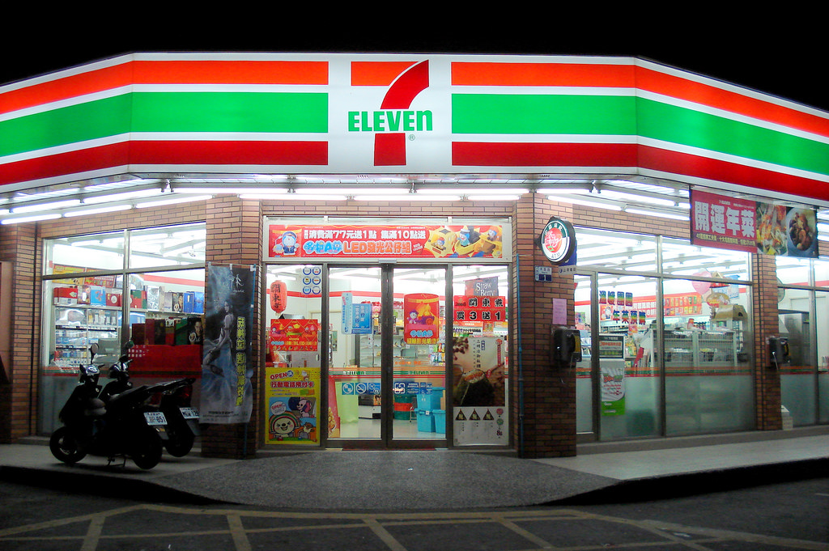
Retail Formats
Convenience Store-Stores that are convenient shopping
for customers; they are close-by and are easily accessible.
These stores are small in size with quick shopping and checkout.
Product pricing is higher
and selection is limited.

Slide 12
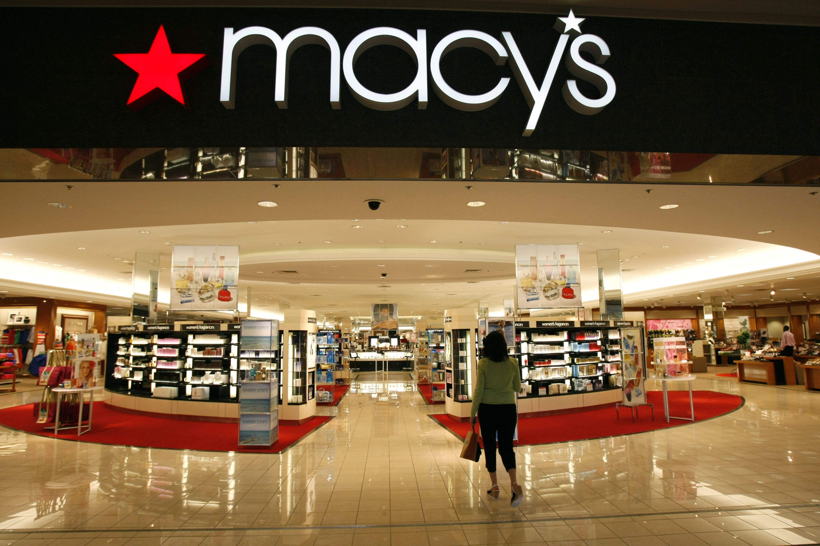
Retail Formats
Department Store-these offer good service and sell a
Large variety of products of mid-to-high quality products.

Slide 13
Retail Formats
Direct Selling-a salesperson contacts a customer directly often at the customer’s home. The salesperson demonstrates the products, talks about the benefits of ownership, takes the
order and delivers the product (or service).

Slide 14
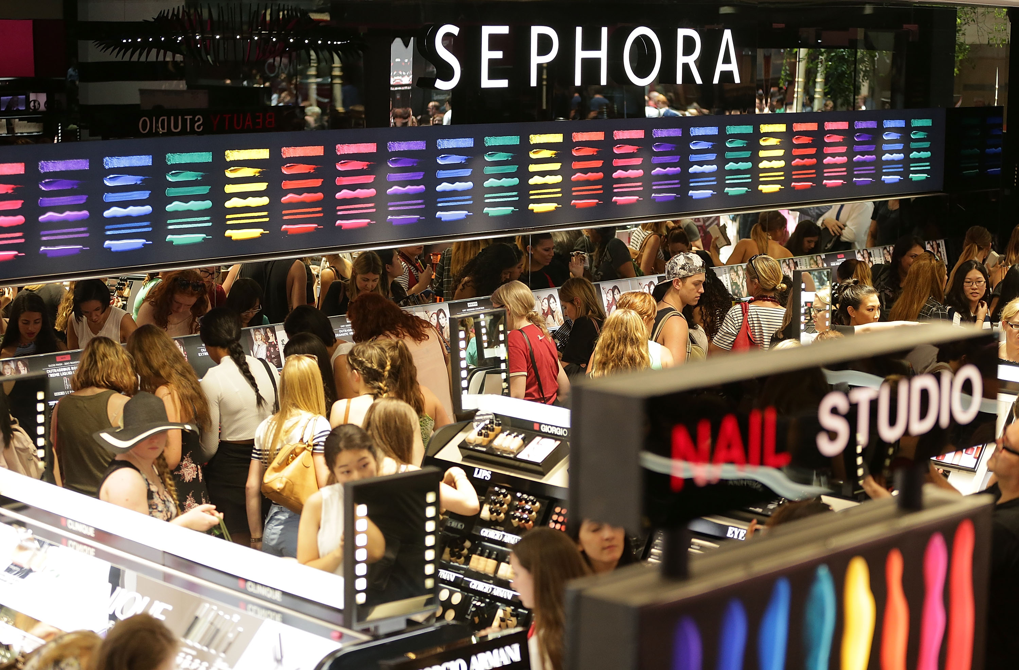
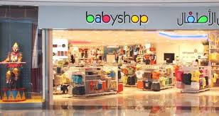
Retail Formats
Specialty Stores-sell to a special group of people. These
customers usually like the extra customer service that comes
with the shopping experience.

Slide 15
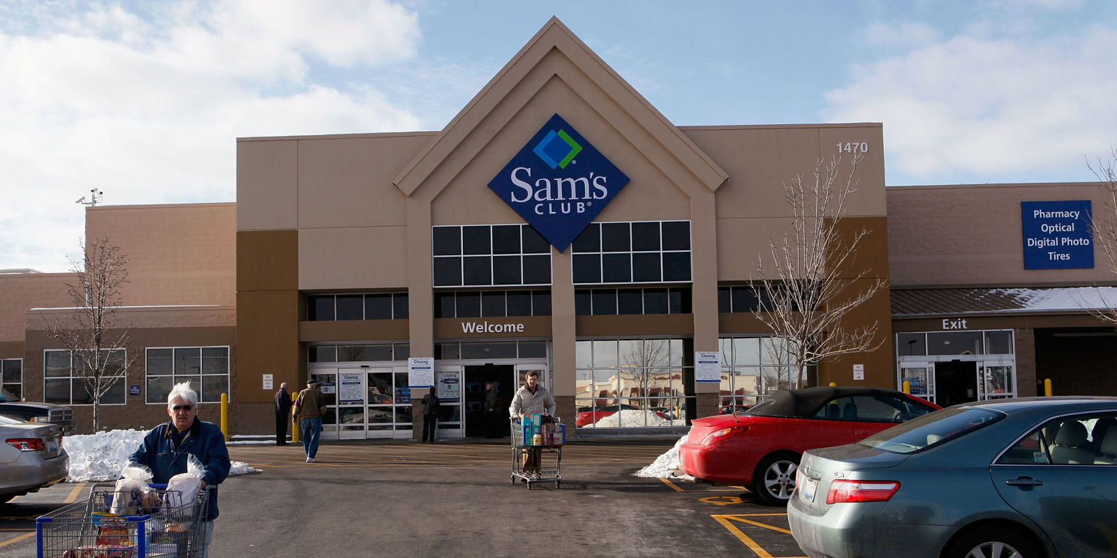
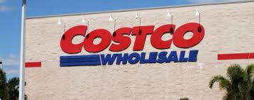
Retail Formats
Wholesale Clubs-stores where wholesalers sell products directly to consumers. This is an example of a wholesaler selling directly to a customer. They usually also carry products
from other wholesalers.

Slide 16
Retail Formats
Other types of Retail Stores:
Discount Stores-offer a broad variety of merchandise at low prices and very little service Off-price Retailers-offer brand-name products at discounts; these
are usually leftovers from other stores Pure Play-retailers who started online and continue that format Supercenters-stores that combine supermarket and department stores Thrift Stores-sell second-hand products

Slide 17
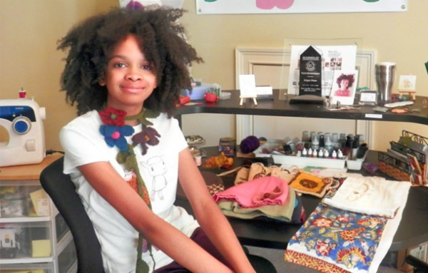
Types of Retail Ownership
Independent Establishment-a single store of small, regional
chain. They meet the needs of local customers.
95% of all retail companies are considered independent establishments.

Slide 18
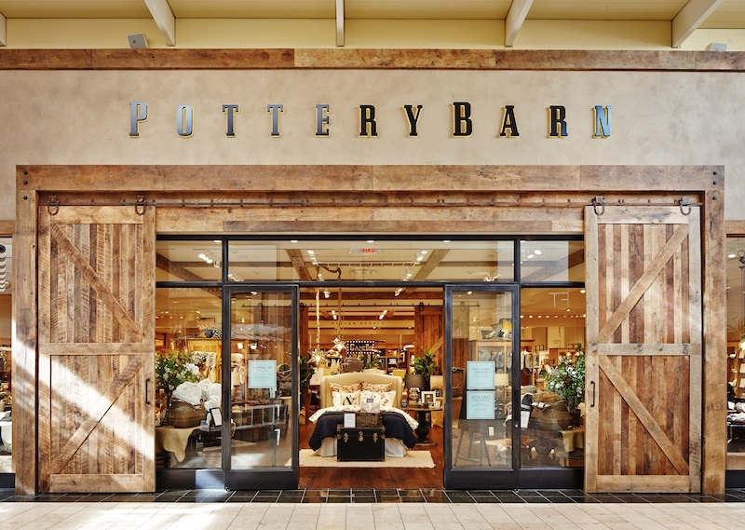
Types of Retail Ownership
Corporate Chain-operates many stores under the same
ownership and usually has centralized decision-making.
Because they buy for several stores, they can get lower
costs when making large purchases and pass that on to
their customers.

Slide 19
Types of Retail Ownership
Franchise-a store licensed by a successful store given the
licensee the right to duplicate the successful business
usually in a particular geographic area.
The license has rules that the new franchise store must abide by.

Slide 20
Retail Channels
Brick & Mortar Stores-these have a physical building and
have face-to-face interaction with customers.
E-Commerce Stores-buying and selling are done over the internet.
Multichannel Stores-retailers that sell in a brick & mortar store
as well as through online.
Omnichannel Stores-these are similar to multichannel stores but have a seamless consumer experience, meaning you could buy
something online and pick it up at a physical store.

Slide 21
Chapter 1: Retail Industry Overview
1.2 Understand the Customer
Recognize the various types of customers
Understand consumer behavior and the importance of the sales associate in facilitating customer’s purchase decisions
Understand how retail impacts communities

Slide 22
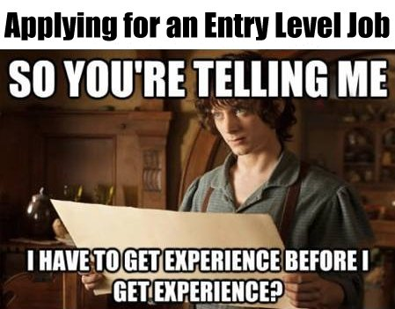
What is an entry-level position?
It is a low-level job in which an employee may gain skills or experience; low-level jobs lead to more advanced positions.
What is a sales associate?
This person is the front line representative of any retail business. This person must
greet customers
listen to their needs
finalize the sale
package the product for the customer’s trip out of the store

Slide 23
Why are there so many kinds of Retail Store?
Customers are all different, so getting to those customers
requires different types of store formats.
What kind of customer are you?
Do you shop for fun or only when you need something?
Do you prefer to shop alone or with friends/others?
Do you research your purchase options ahead of time?
Do you follow retailers on social media?
Are you loyal to any brands or stores?
Are you the first one to purchase a new technology?
Has a TV or Radio add ever influences you to make and impulse buy?
What role do sales promos, coupons and discounts play in your shopping?

Slide 24
Types of Customer
Innovative Customer-wants to be the first to purchase the latest
fashion trend or newest technology; a trendsetter.
Comparison Shopper-spends time checking out products through ads, visiting various stores, searching online for the best price or deal.
Impulse Buyer-a person who makes a quick purchase decision usually for inexpensive items.
Follower-a person who wants to see what everyone else is buying and then makes the purchase.
Diverse Shopper-a person who is hard to predict or understand and shops in many different places so he/she is not influenced by any one retail store.
Recreational Shopper-a person who shops for fun; enjoys walking through stores, trying on things, testing them out. This shopper does not need to make the purchase.

Slide 25
Five Stages of Decision-Making
A good retailer needs to understand a customer’s needs, habits, and purchase behavior.
A good retailer does not try to sell ALL things to ALL people.
Successful retailers select a specific target market (a typical customer) who has the need, desire and ability to make a purchase.
Only then can a retailer identify their customer’s purchasing-decision making process.
Usually a customer goes through 5 stages in making a purchase decision. These are:

Slide 26
Five Stages of Decision-Making
Need Recognition-customer knows that some product/service might solve a problem or fulfill a need
Information Search-customer will then determine which goods/services will solve their problem and compare all of the options and other alternatives
Evaluation of Alternatives-customer will mentally rank the alternatives based on how it best solves their problem and decides which is the best option
Purchase-customer decides where the best place is to buy the product/service (location of store, store
image, customer service, pricing, etc.)
Post-Purchase Evaluation-the customer reviews the decision to make the purchase sometimes having “buyer’s remorse” and sometimes thinking, “This was a great purchase.”

Slide 27
Chapter 1: Retail Industry Overview
1.3 Recognize the Economics of Retail
Illustrate the importance of the retail industry in the U.S. economy
Understand the economic impact of retail
locally

Slide 28
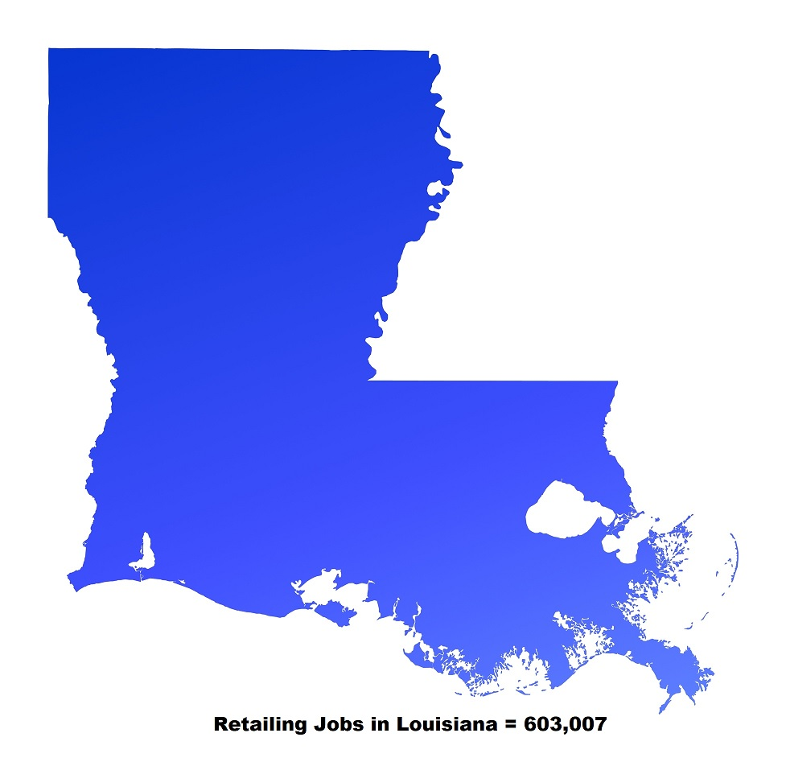
Importance of the Retail Industry
Retailing drives virtually every facet of our economy and supports tens of millions of jobs in the U.S. Retailers support 1 in 4 American jobs, and are the heart around which communities
are built, grow and prosper.
Retail generates trillions of dollars for our economy which means that 1/6 of the total U.S. Gross Domestic Product (GDP) comes from Retailing.
Retailing Jobs in
California = 4,713,658
Texas = 3,509,910
Virginia = 1,057,777
Florida = 2,698, 777

Slide 29
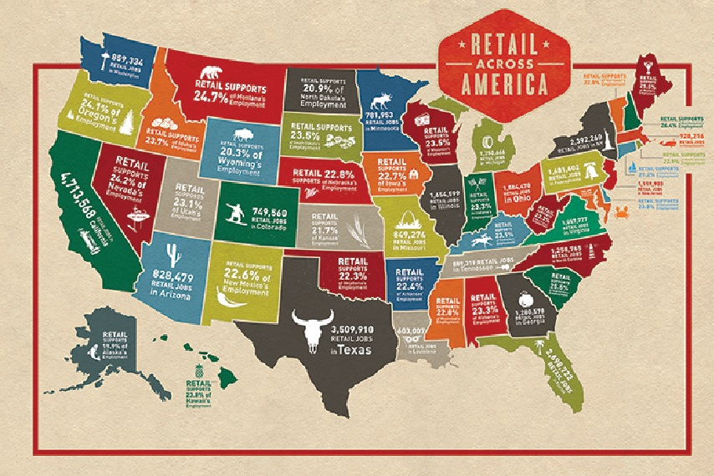
Importance of the Retail Industry

