Slide 1
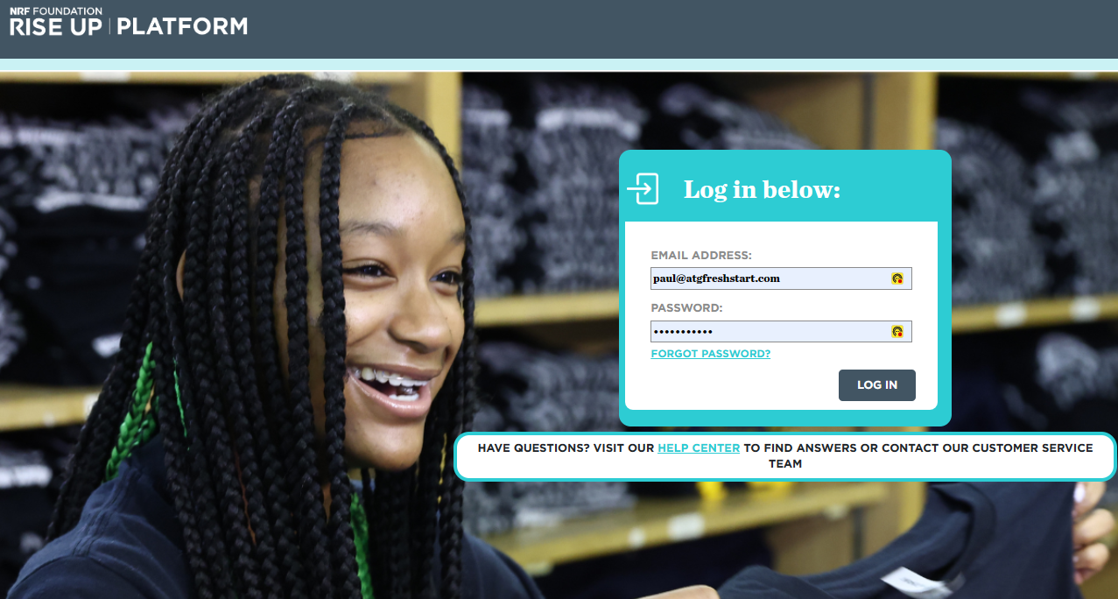

Using A
Rise Up Account in Customer Service or Business of Retail and the www.ATGfreshstart.com website

Slide 2
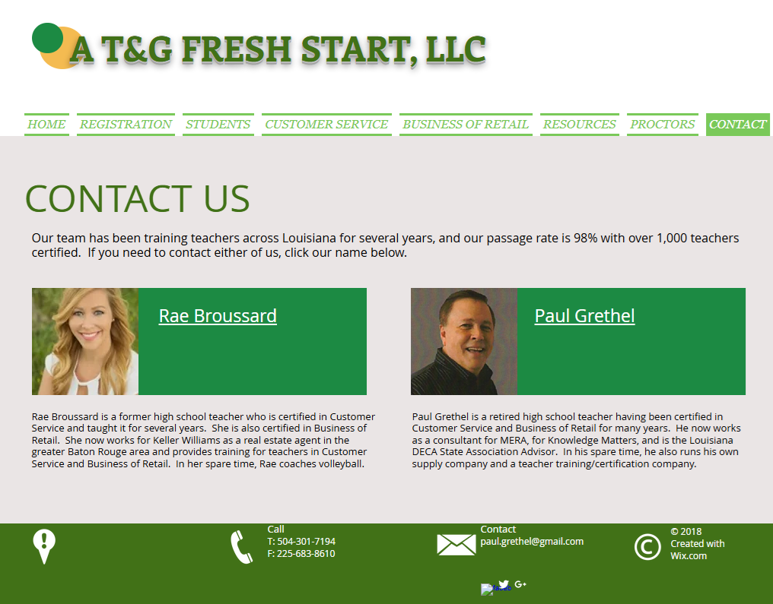
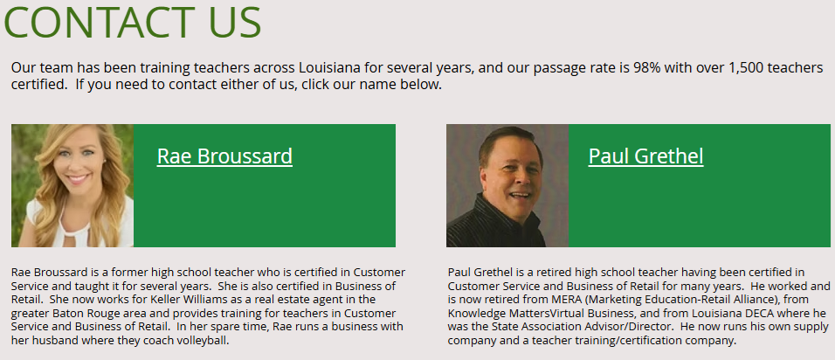

Slide 3

DECA is an academic, professional association of high school and college students with an interest in careers within the fields of
Marketing
Finance
Hospitality and Tourism
Retailing
Business Management
Business Administration
DECA's purpose is to:
integrate into classroom instruction through authentic, experiential learning methods that prepare members for college and careers,
apply learning by having members put their knowledge into action through rigorous project-based activities that require creative solutions with practical outcomes.
connect to businesses to provide members realistic insight into industry and to promote meaningful, relevant learning.
promote competition which drives members to excel and improve their performance.
These purposes determine the character of our chapter activities. DECA prepares the next generation to be academically prepared, community oriented, professionally responsible, and experienced leaders.
DECA is comprised of over 250,000 members in the U.S. and internationally. Louisiana DECA currently accounts for over 1,500 of these members.

Slide 4
Our Suggestion for Teaching a Semester Course with Both
Customer Service and with Business of Retail Courses/Certification
With a class that is about 1 hour long, it takes about 6 weeks to teach each course. This would take up a total of 12 weeks. Since you have 18 weeks in a semester, this will give you 6 weeks to spread out each of your courses and use additional resources to enforce the concepts you are teaching using games, role playing, videos, handouts, etc. We have some of these things on our Resources page at www.atgfreshstart.com.
We suggest you start the semester with Customer Service, then give the credential test to your students. Then teach the Business of Retail course. This course covers a lot of marketing and has a section on Customer Service, which you will have already taught, so this will be a review of those concepts. You can always find more marketing material to add to the course if you have time. Then you would give students their credential exam.
Then we would do the Chapter 5 in either textbook. This covers how students would get a job, keep a job, and leave a job. It's good stuff, but we only recommend it being taught if you have the time to teach it. You can get into creating a resume, looking at various online job recruiting sites, writing a follow-up thank you message/card after an interview, etc.

Slide 5
National Retail Federation Foundation (NRFF)-owns the test, course content, textbooks
Rise Up-platform used to register and test students
Kaleidoscope Learning-company which hosts the
Rise Up platform for the NRFF
A T&G Fresh Start–not affiliated with any of the above but is a source of classroom materials for teachers in Louisiana.

Slide 6
A T&G Fresh Start LLC
Website
www.atgfreshstart.com
Help for teachers, proctors, and students

Slide 7
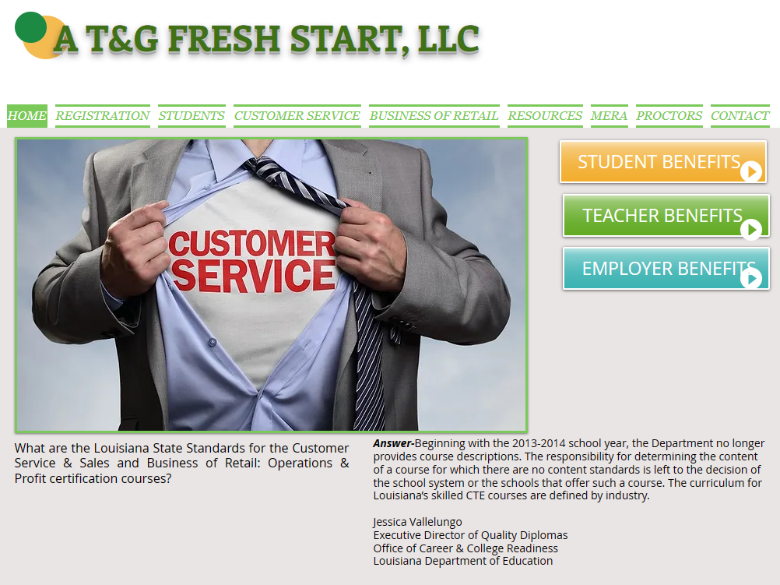
Our Customer Service
And Business of Retail Teacher Website
We have our own website for Louisiana teachers who teach Customer Service and Business of Retail.
Please pull up www.atgfreshstart.com.
Think of this website as your file cabinet.

Slide 8
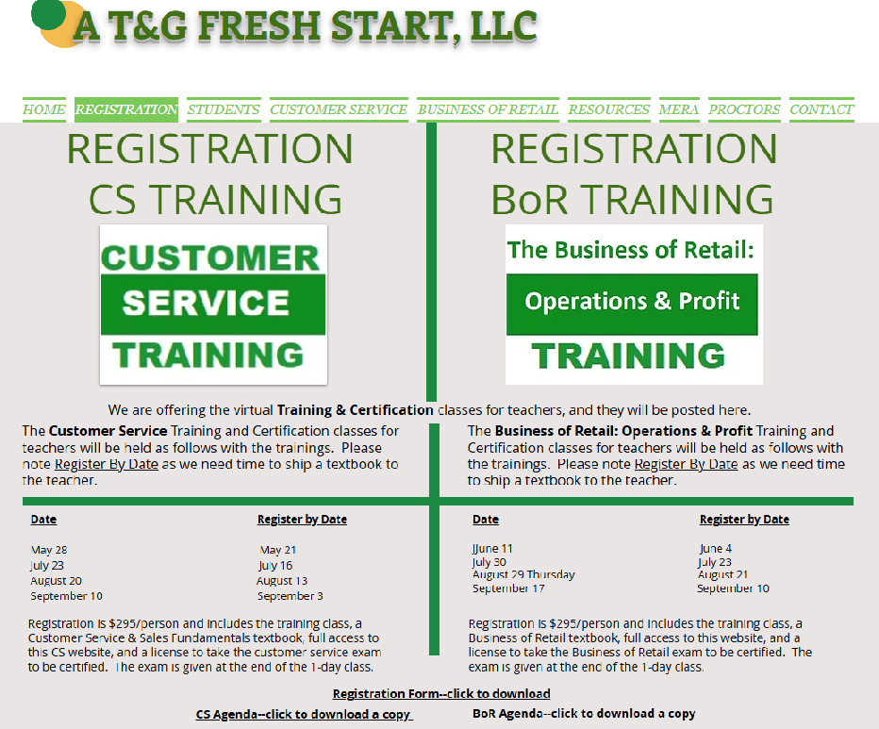
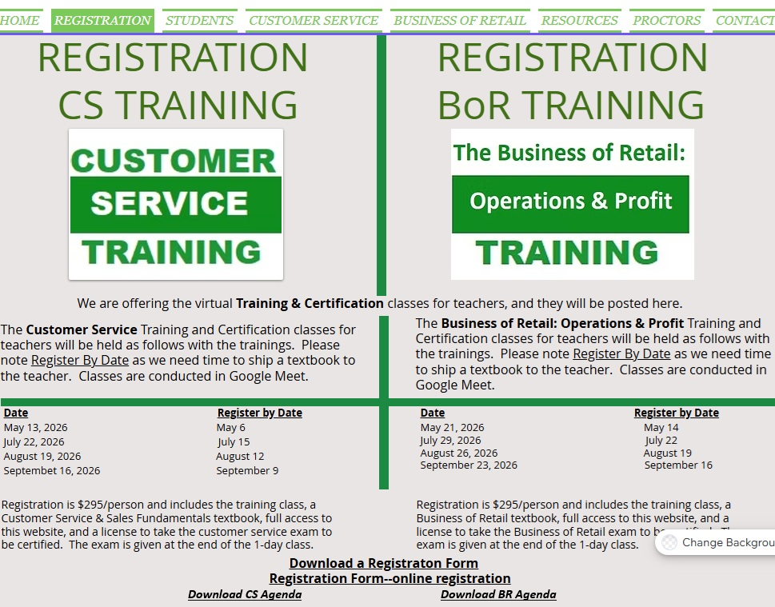
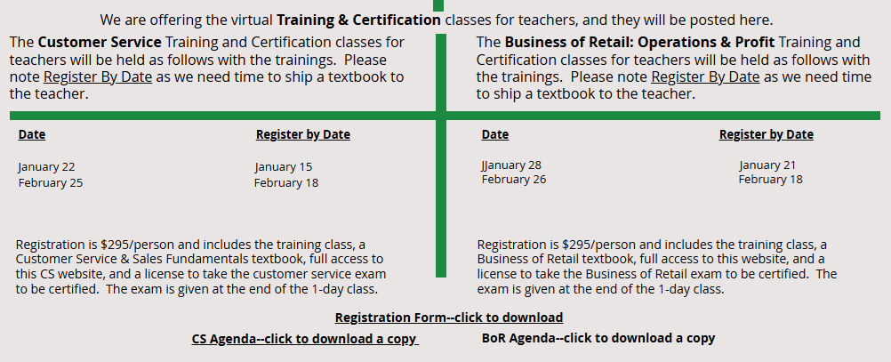

Slide 9
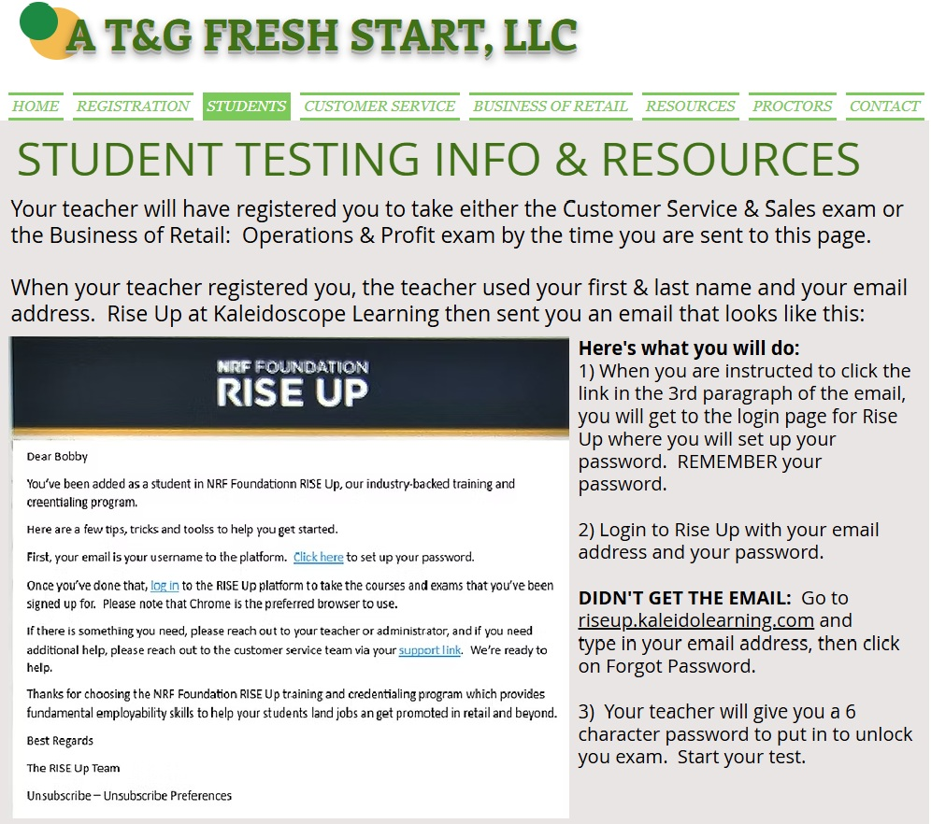

Slide 10
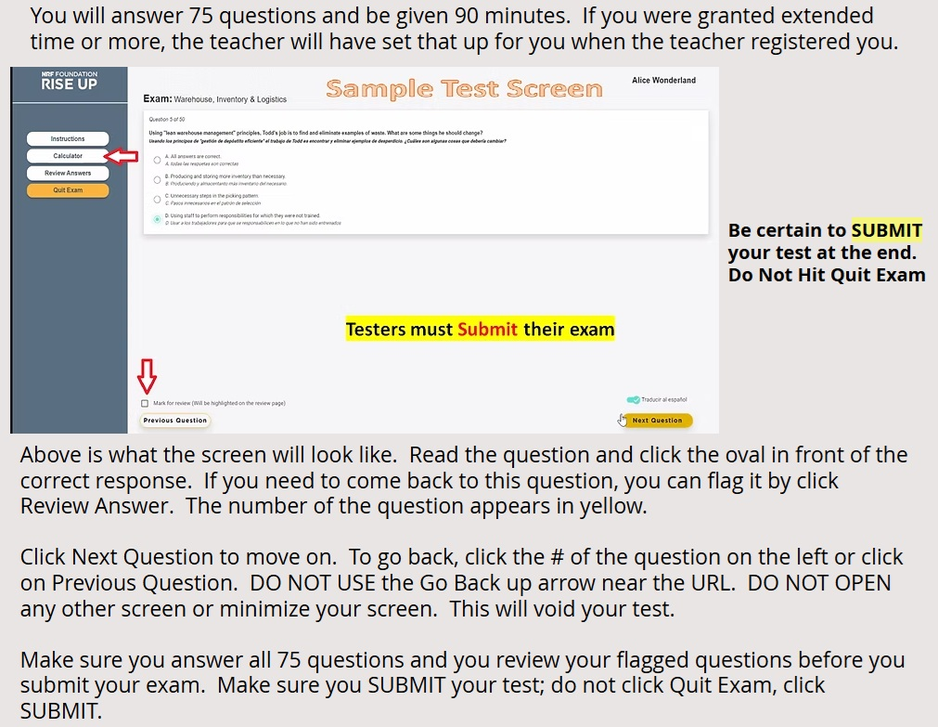
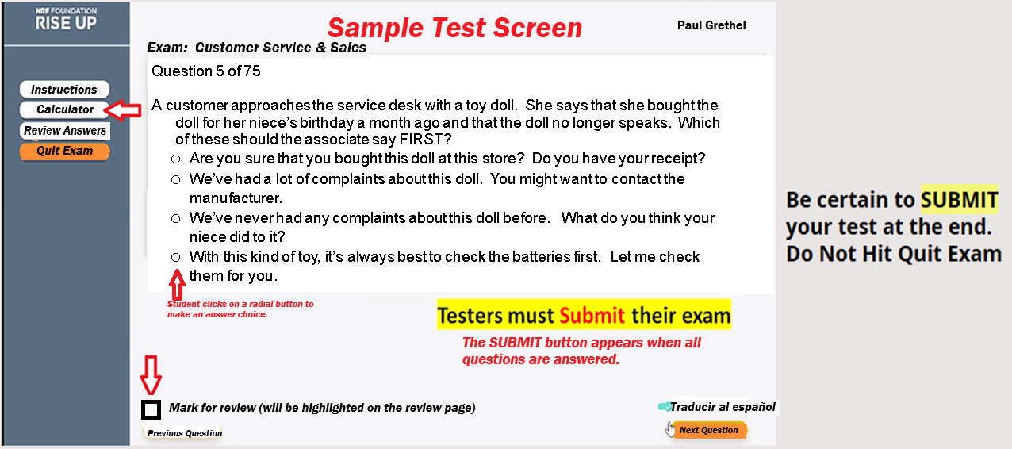
Convert to Spanish

Slide 11
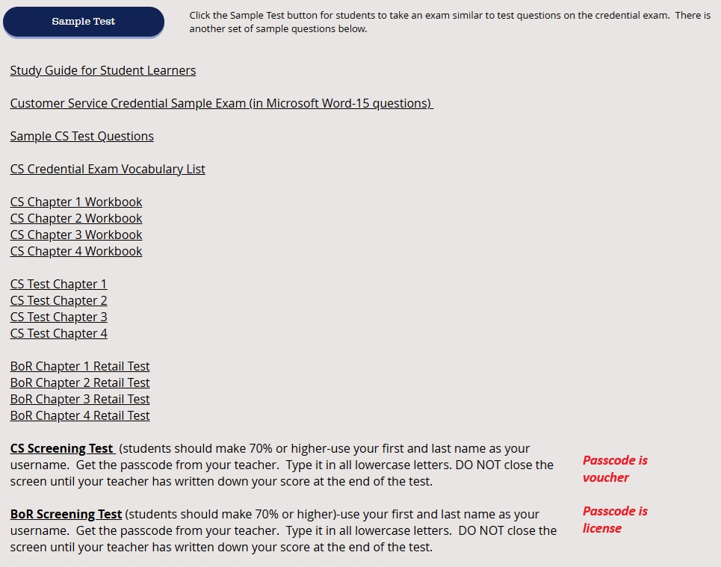

Slide 12
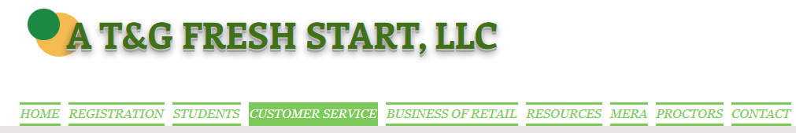
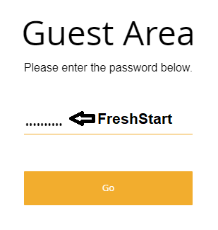
Click on Customer Service or Business of Retail to access the Class Materials.
Use this password to get into these 2 pages. They are password protected because the contain answer keys.

Slide 13
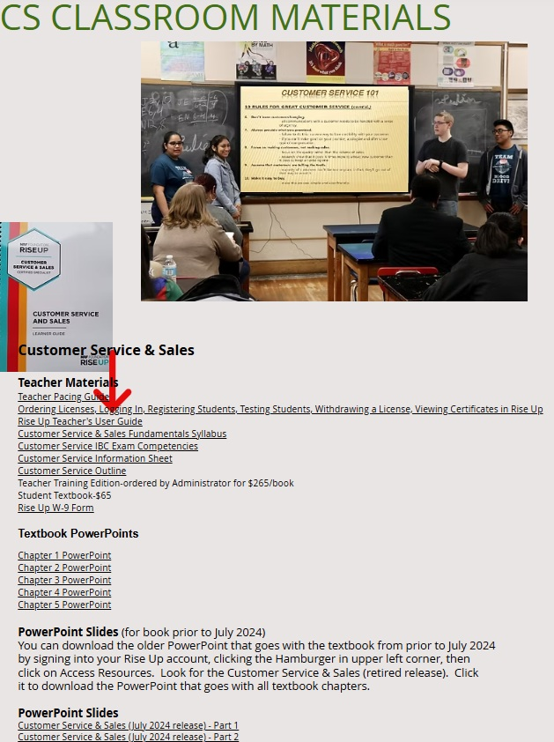
Infographics have
been added.

Slide 14
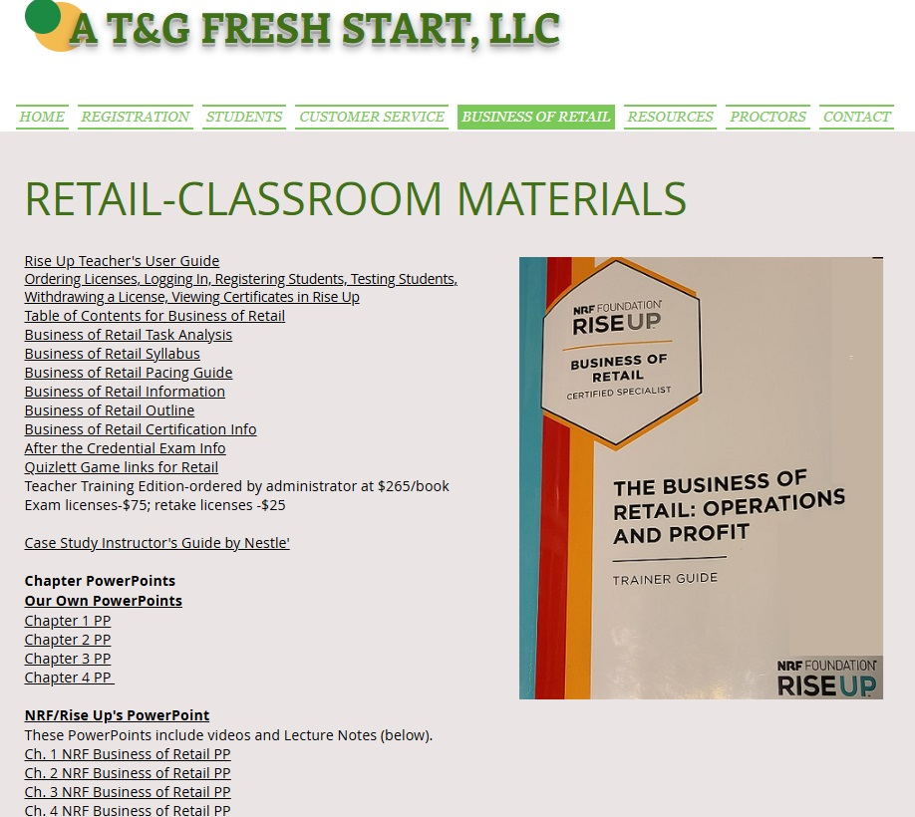

Slide 15
SCREENING TEST
After you have taught the course, give the Screening Test.
A student should earn 70% or higher on the screening test or should study and retake it. The provided CS screening test is 100 questions; the BoR test is 50 questions.
Written screening test:
Go to Customer Service tab at www.atgfreshstart.com.
Go to Business of Retail tab at www.atgfreshstart.com.
Online screen test:
Have students go to www.atgfreshstart.com and click on Student tab
Password for the Customer Service is voucher.
Password for the Business of Retail is license.

Slide 16
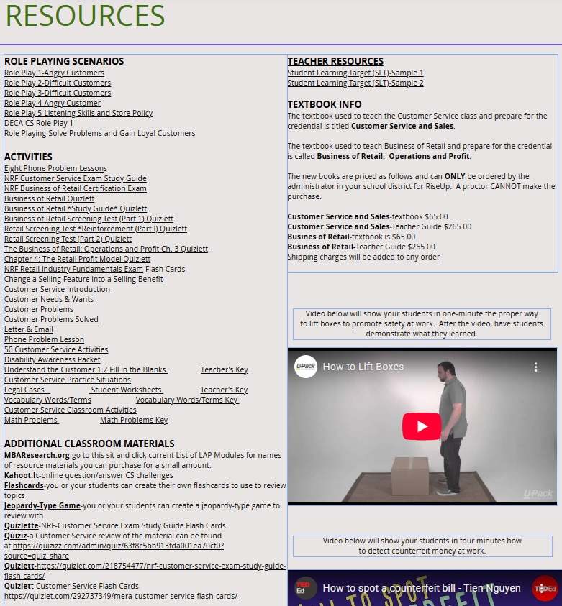

Slide 17
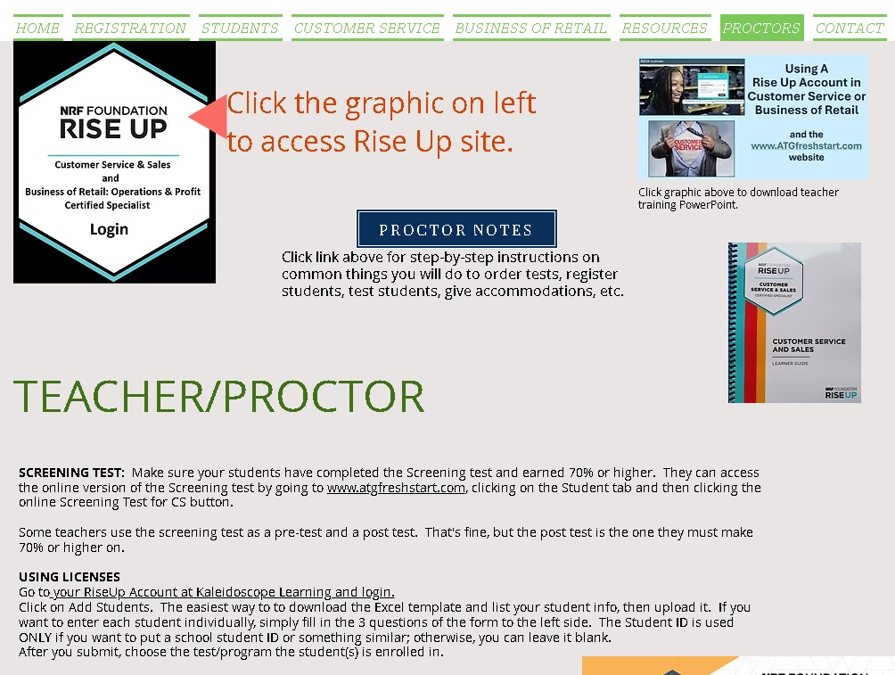

Slide 18
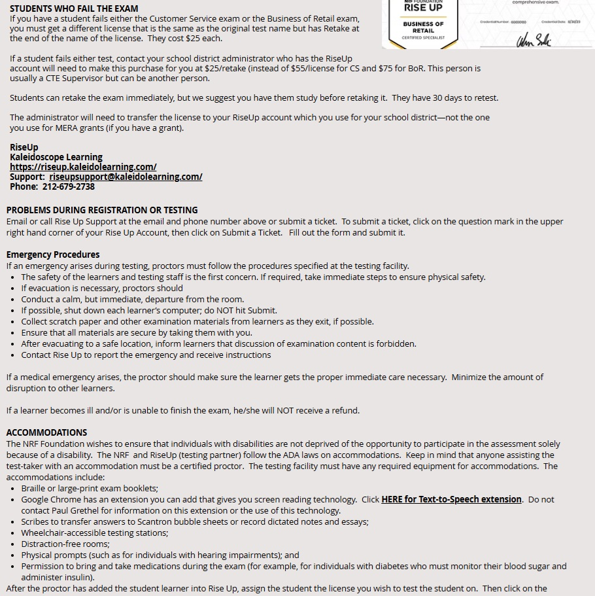
Proctor Page
If you fail the credential exam today, contact me. You must mail us a check for $25, and I will purchase your Retake exam so you can retest.

Slide 19
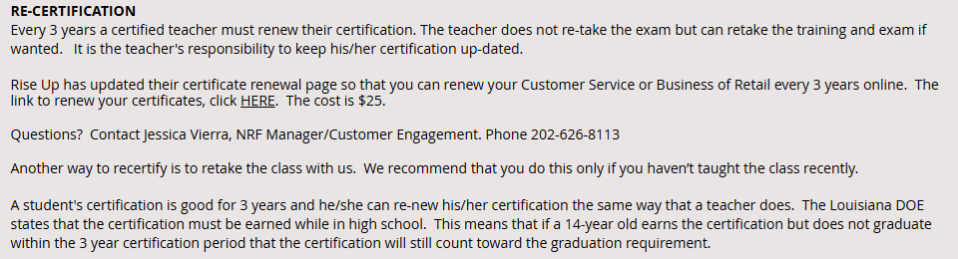
Proctor Page
$25

Slide 20
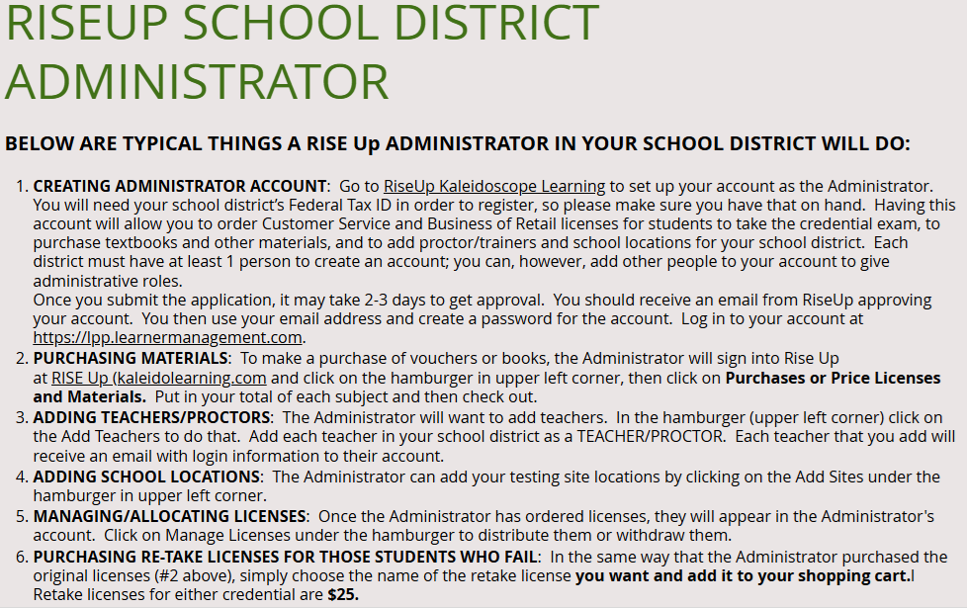
Below are the duties that your Rise Up District Administrator can do.
After you pass your credential exam today, send a copy of your certificate to your Rise Up District Administrator at your School Board office and ask that person to add you as a “teacher/proctor” in the Rise Up testing website.
Once they do, you’ll receive an email from Rise Up. Click the link given in the 3rd paragraph, then create a new teacher account using your teacher email address.
Once you get into you teacher account at Rise Up, click the Hamburger, and click “Apply to be a Proctor.” Agree to the rules.

Slide 21
Using the Rise Up Testing Platform on Kaleidoscope Learning
For Customer Service
or Business of Retail Testing

Slide 22

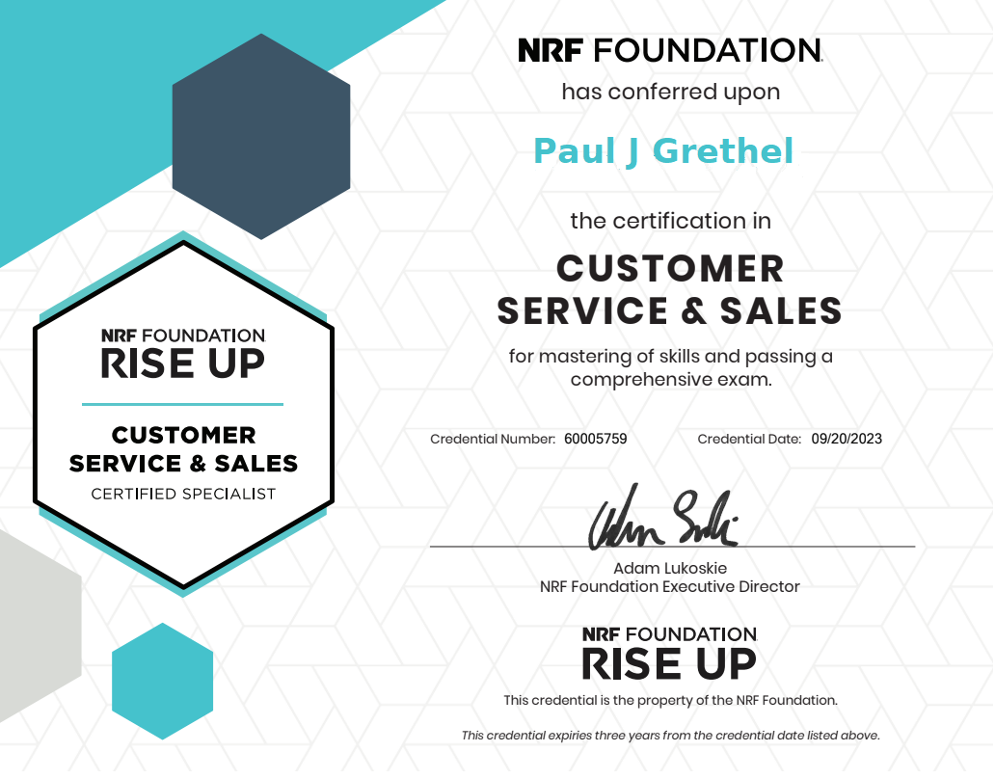
As a Student in Rise Up
Today, you are considered a student in this virtual training.
Before you got to this class, your trainer/proctor did the following:
Registered you in Rise Up for the class by uploading your PERSONAL email address and your first
and last name.
Assigned you a license to take the credential exam.
Sent you an email with the link to this virtual class and had Rise Up sent you an email message
stating you have been enrolled along with a link to set up your testing account.
Once you got into today’s class, you did the following:
Clicked the link in the Rise Up email and set up your password for your STUDENT account. If you
did not receive the email from Rise Up, you went to www.riseup.kaleideolearning.com, put in your
personal email and then clicked Forgot Password.
Once signed in, you saw the name of your credential exam.
After the training, you did the following:
Signed into your Student Account at Rise Up
Clicked on the name of the credential exam
Typed in the daily exam code given to you by today’s instructor.
Took your exam.
Received a copy of your certificate via email if you passed the exam.

Slide 23

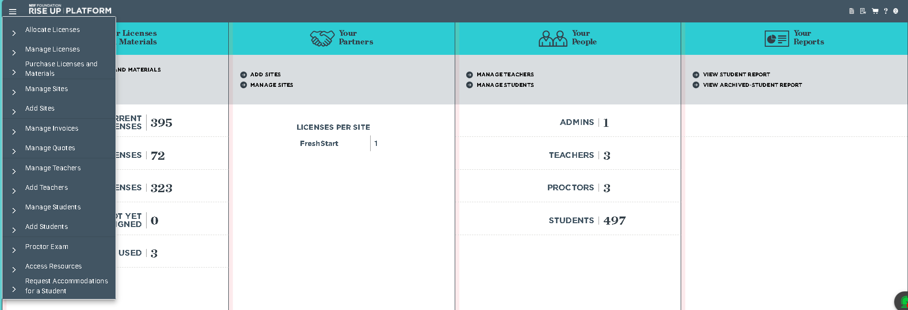
You conduct all business in Rise Up by using the Hamburger
Once you click the Hamburger, you get a drop-down menu from which to choose.

Slide 24
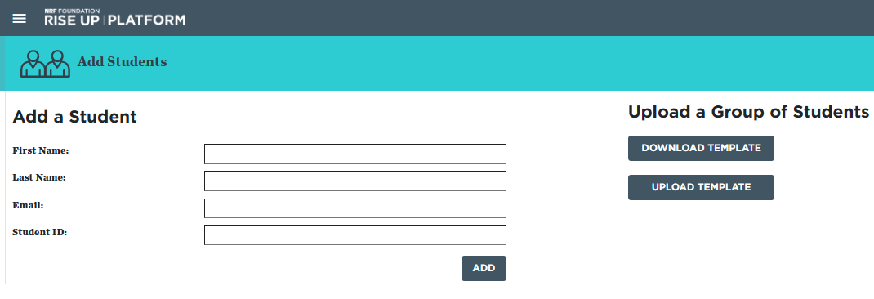
Instructor Enrolls a Student.
Paul
Grethel
Paul.Grethel@gmail.com
Register students one at a time, then
they can take as many courses
or tests as needed.
You can also register a large group via template

Slide 25
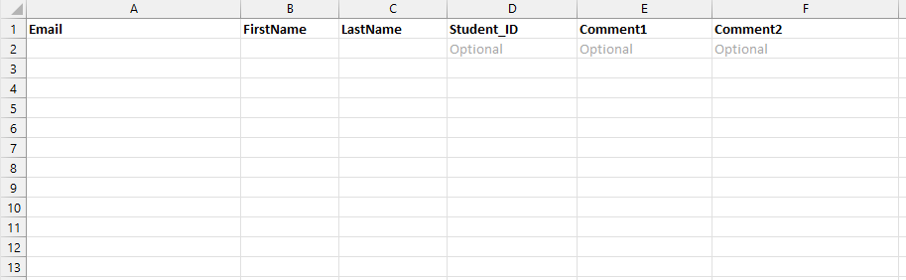
Student ID
This is the template used to upload a large group of students. Fill it out, save it, upload it.

Slide 26
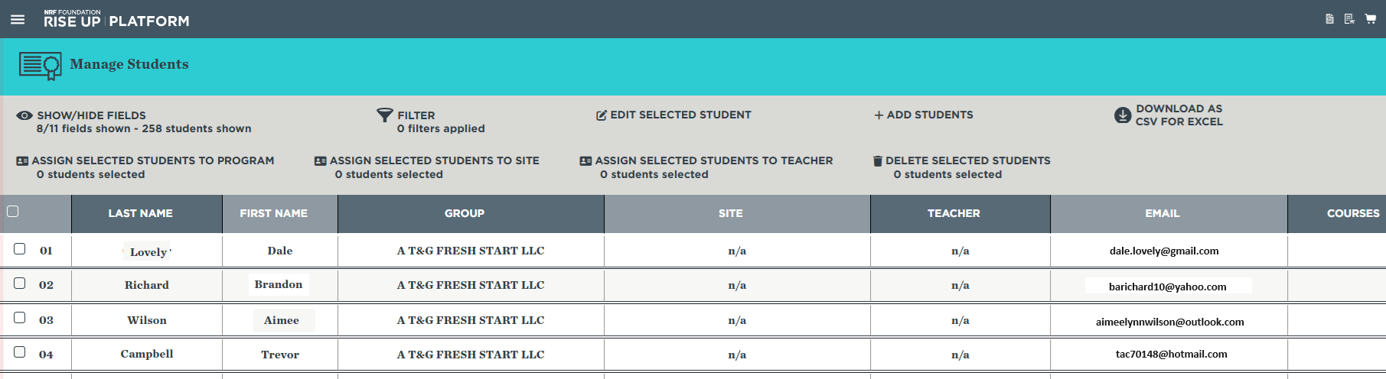
Select the students you want to give a license to. You can check off an individual student or several. You can use the master “select all” above the column also.
Now click on ASSIGN SELECTED STUDENTS TO A PROGRAM
The student now has a license, and an email has been sent to the student to let him/her know. NEVER register your own students and put them under Fresh Start.

Slide 27
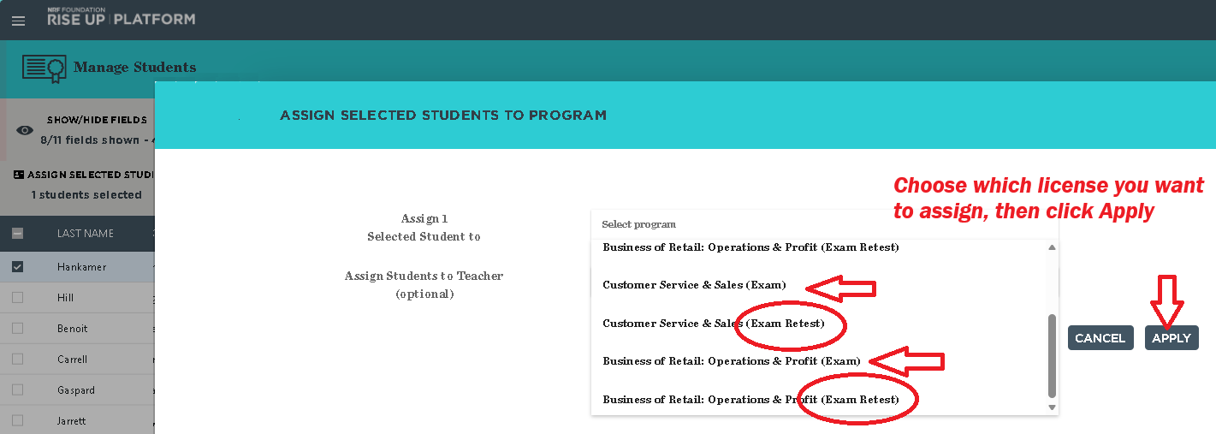

Slide 28
EDITING A STUDENT’S INFORMATION IF THERE’S AN ERROR
If the instructor has made an error in spelling or in the email address, under Manage Students, check off the student who needs to be fixed, then click EDIT SELECTED STUDENT. A screen will pop up with the info where it can be fixed and saved it.

Slide 29
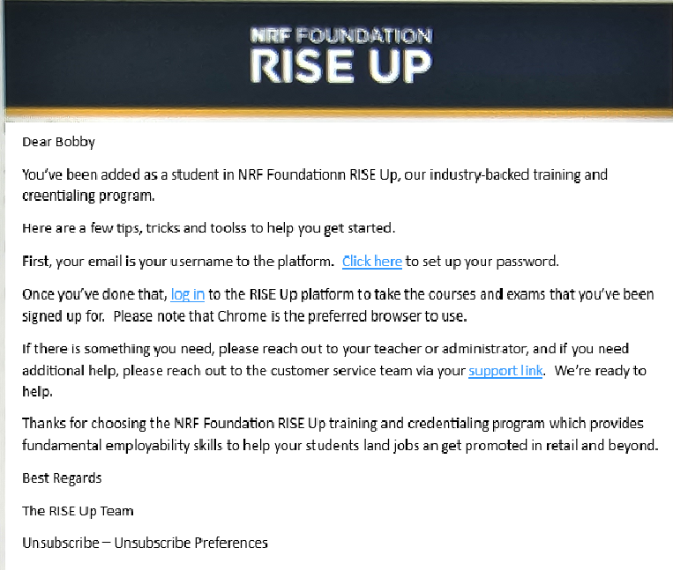
Email
Sent
To
Student
If a student does not get this email, just have them go to www.riseup.kaleidolearning.com

Slide 30
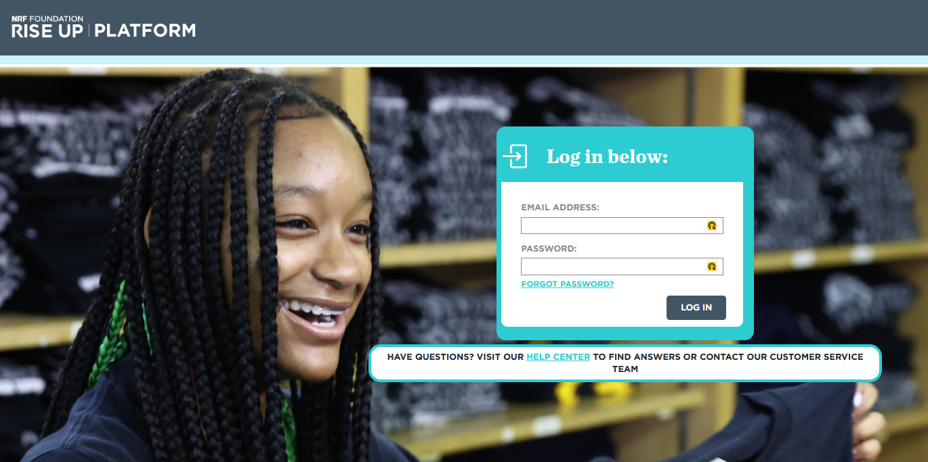
The Rise Up testing site is located at https://riseup.kaleidolearning.com/
Everyone goes to sign in on this page:
Students
Teacher/Proctors
Administrators

Slide 31
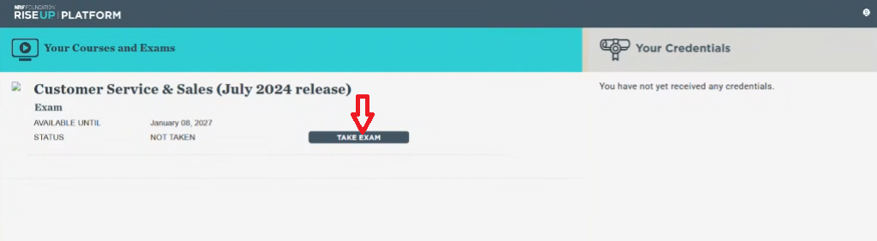
Once you are certified,
your certificate will
appear here.
Login to your Student Account with your personal email address to access your certification certificate.

Slide 32
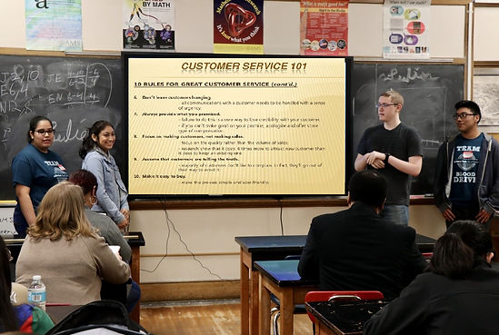
Setting Up Your TEACHER/PROCTOR Account
Once you pass your Student credential exam:
Send a copy of your certificate to your school district’s Rise Up Administrator—probably the person who
is paying for you to attend this training.
Ask the administrator to add you as a Teacher/Proctor in their Rise Up account.
When the administrator does, you will receive and email from Rise Up will automatically with a message
stating you have been enrolled as a teacher along with a link to set up their teacher account using your
school email address. Do not use your Student account which is under your personal email address.
Click the link in the email and set up your password for your Teacher account.
Once in Rise Up, click on the Hamburger in upper left corner.
Under the Hamburger, click on Apply to Be a Proctor, then agree to the rules.
You are now officially a teacher/proctor in Rise Up and can test students.

Slide 33
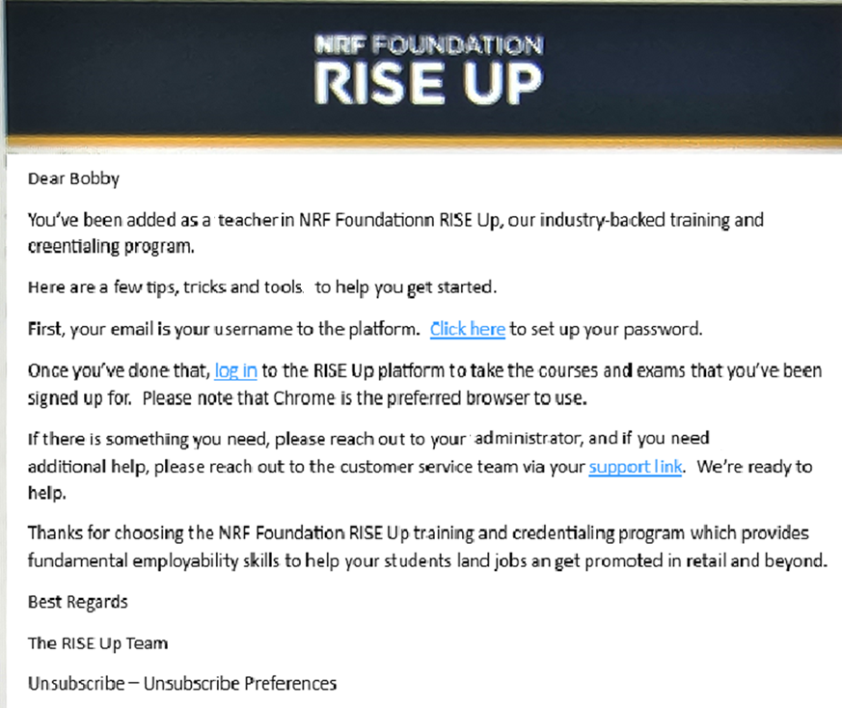
LOGIN IN FOR THE FIRST TIME AS A TEACHER
Once your School District
Rise Up Administrator adds you into their account as a Teacher, you’ll get this email.
You now have a link to set up your password, a link to the site to log in, a link to look at intro webinars, and a link to the Help Center.
If you do not get this email and are sure your administrator added you, just go to www.riseup.kaleidolearning.com

Slide 34
The Rise Up testing site is located at https://riseup.kaleidolearning.com/
Everyone goes to sign in on this page:
Students
Teacher/Proctors
Administrators
Use Your Teacher Email

Slide 35
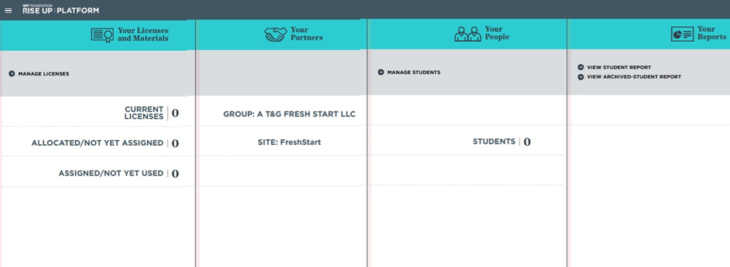
This is your Dashboard page or Home page. Anytime you want to get back to it, click the words “Rise Up Platform” in upper left side.

Slide 36
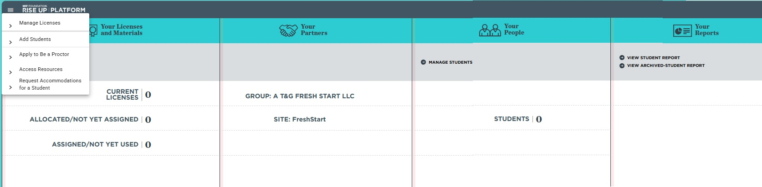
Once you are added by your administrator in their account as a Teacher/Proctor, sign into your Rise Up teacher account using your school email address and click on “Apply to Be a Proctor” under the Hamburger.
You must agree to the proctoring rules. Once you agree, you will have other items populate into your Hamburger drop-down menu.

Slide 37
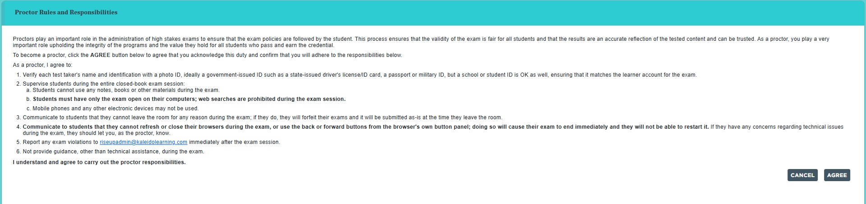
You must agree to the rules of being a proctor in order to gain full use of your Rise Up Teacher/Proctor site. Click on AGREE.

Slide 38
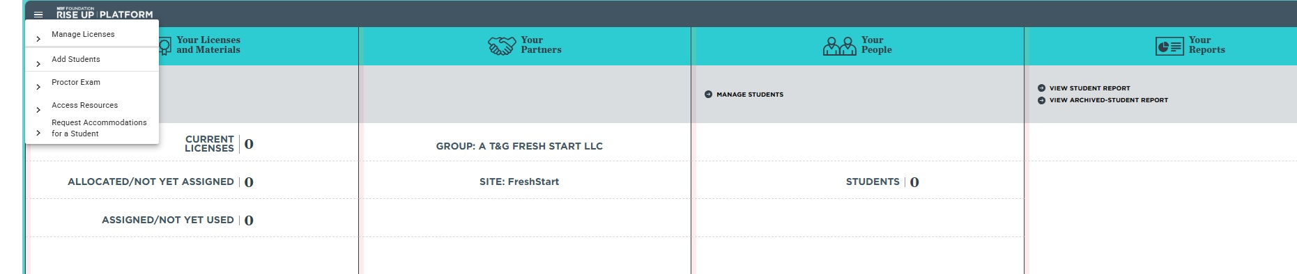
Once you agree to be a Proctor, your Hamburger will add more activities, such as Proctor Exam.

Slide 39
What the Teacher/Proctor Does with Students in Rise Up
After teaching the 4 chapters for the class, the trainer/proctor will do the following:
Register each student in Rise Up for the class by uploading each student’s email address and their
first and last name.
Assigned each student a license to take the credential exam. You must have licenses in your account
in order to do this.
Rise Up will automatically send each student an email message stating the student has been enrolled
along with a link to set up their testing account.
Once the day comes where the student will take the credential exam, they will:
Click the link in the Rise Up email and set up their password for their STUDENT account. If the student
did not receive the email from Rise Up, send them www.riseup.kaleideolearning.com, where they are
to put in the same email you put in to register them, and they
then click Forgot Password.
Once signed in, they should see the name of their credential exam.
The student should Click on TAKE EXAM button on right.
Type in the daily exam code that the instructor gives them.
Take the exam.
Receive a copy of their certificate via email if they passed the exam.
Teacher should then print out a copy of each student’s certificate and give to
Appropriate person (counselor) at school for graduation purposes.

Slide 40
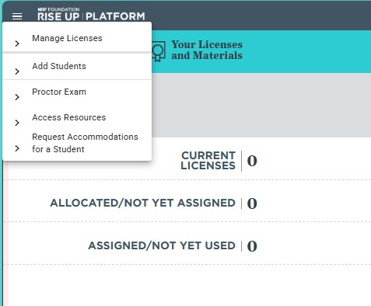
ENROLLING STUDENTS
Let’s add students. To do so:
click on your Hamburger and
click “Add Students”

Slide 41
Instructor Enrolls a Student.
Paul
Grethel
Paul.Grethel@gmail.com
Register students one at a time, then
they can take as many courses
or tests as needed.
You can also register a large group via template

Slide 42
Student ID
This is the template used to upload a large group of students. Fill it out, save it, upload it.

Slide 43
Select the students you want to give a license to. You can check off an individual student or several. You can use the master “select all” above the column also.
Now click on ASSIGN SELECTED STUDENTS TO A PROGRAM
The student now has a license, and an email has been sent by Rise Up to the student to let him/her know they have been assigned a test license.

Slide 45
Email
is
Sent
To
Student
If a student does not get this email, just have them go to www.riseup.kaleidolearning.com

Slide 46
EDITING A STUDENT’S INFORMATION IF THERE’S AN ERROR
If the instructor has made an error in spelling or in the email address, under Manage Students, check off the student who needs to be fixed, then click EDIT SELECTED STUDENT. A screen will pop up with the info where it can be fixed and saved it.

Slide 47
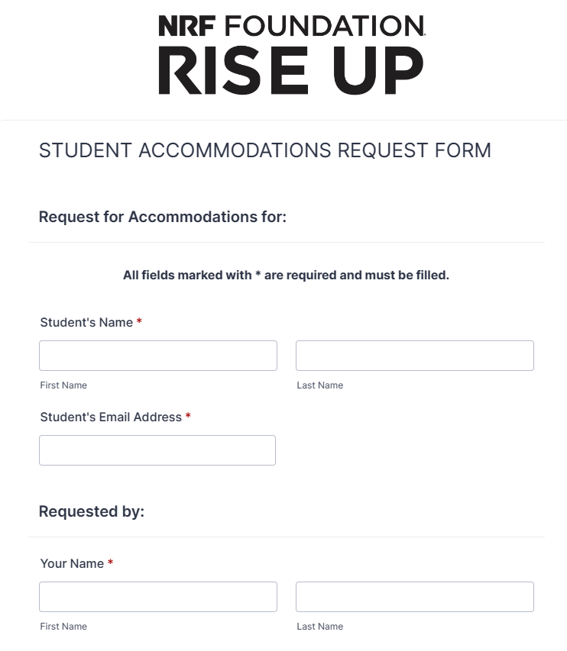
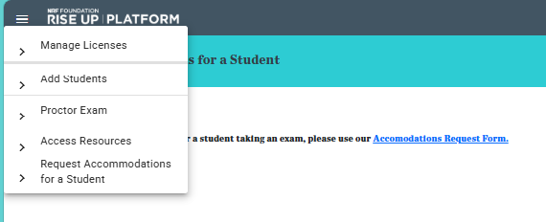
SETTING UP STUDENT ACCOMMODATIONS
Do this about 5 days prior to testing
1
4
2
3

Slide 48
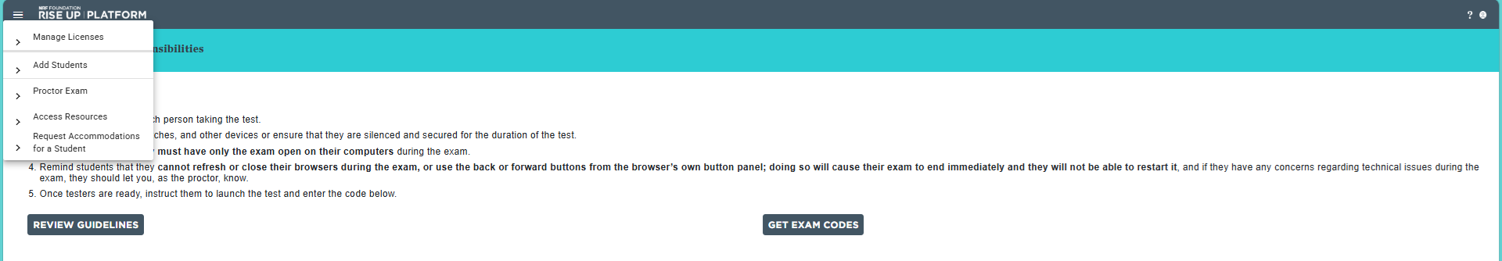
Students can’t start it until you give them the daily password. The code is your way of controlling when students test. Click the Hamburger, then click Proctor Exam.
To get the daily password, click your hamburger, click Proctor Exam, click Get Exam Codes

Slide 49
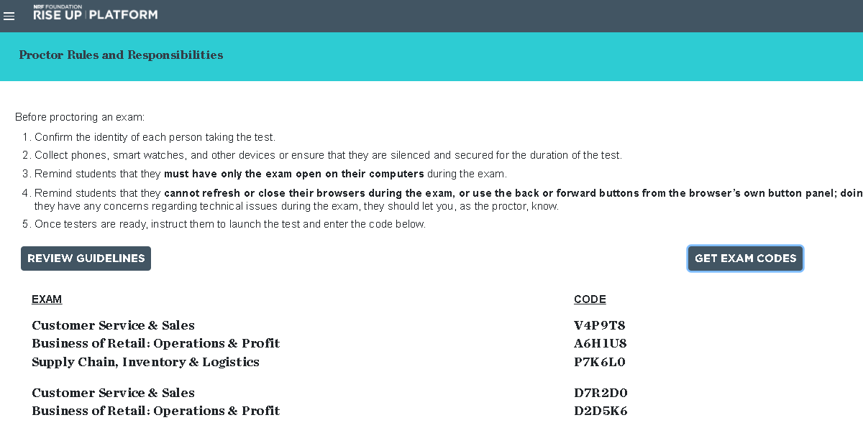
You give students a daily code to start their test.
This give you control of when they start.
The codes change at midnight each day.
The code is 6 characters. The 1st is a letter of the alphabet, then a #, then a letter, a #, a letter and finally a #.
These codes are for the test prior to 2024. Do not use these codes.

Slide 50
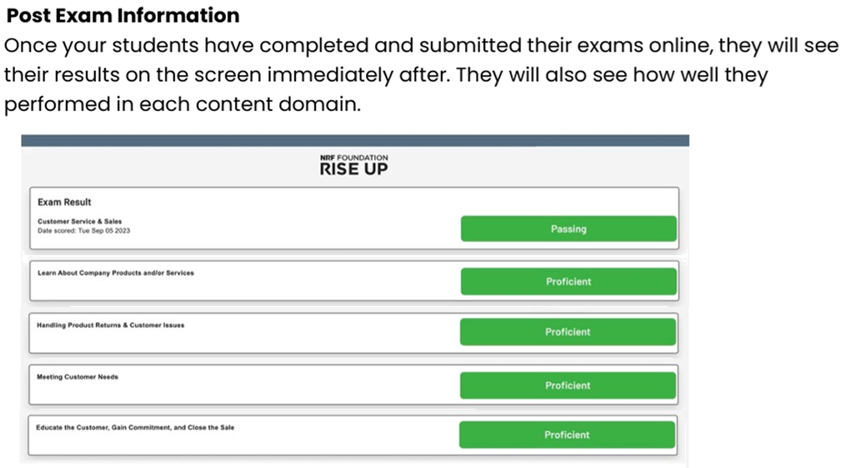

Slide 51
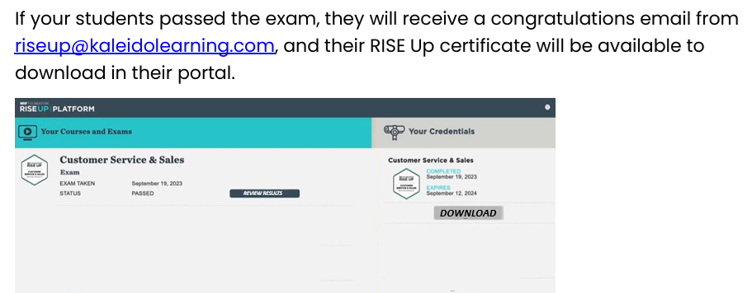
This is found in the STUDENT account.

Slide 52
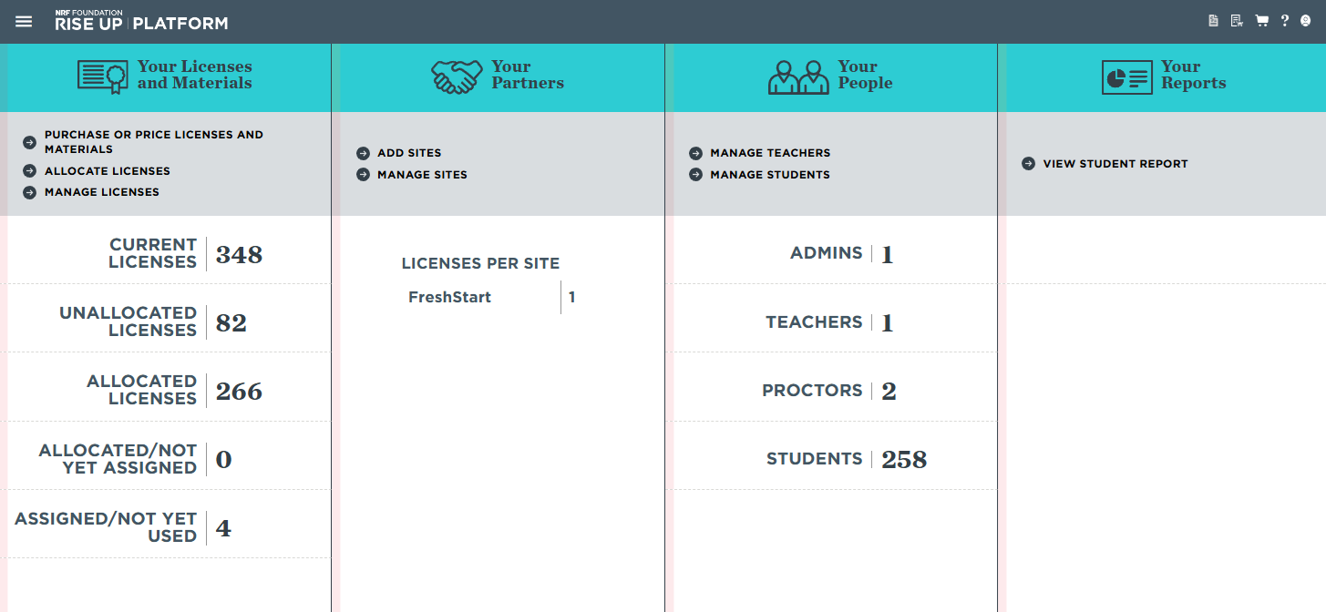
TO ACCESS STUDENT CREDENTIAL CERTIFICATES
AFTER THE TEST
Go to your Teacher Rise Up Dashboard
(click the words “Rise Up Platform” to get to Dashboard)
On the right side, click on View Student Report
You may need to scroll over…

Slide 53
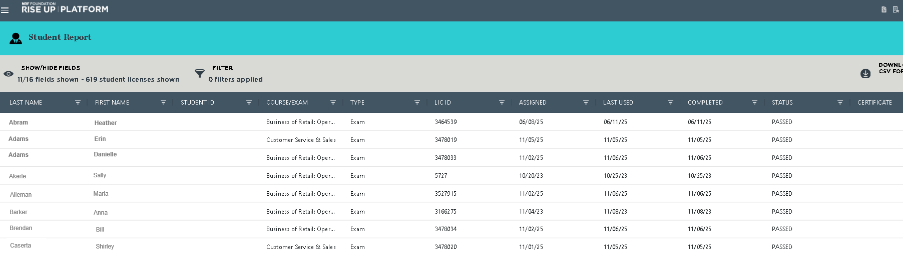
Proctor--to access student certificates:
Click on View Student Report (under Your Reports column) on right side.
Look for the student’s name, then click the eyeball in the Certificate column to download the certificate.
Under the
View Student Report
You may need to scroll over…

Slide 54

Save it,
Print it,
Email it.
Get a copy to
the person at
your school who must upload these
to the Dept. of Ed. for graduation purposes.
70% or better is passing

Slide 55
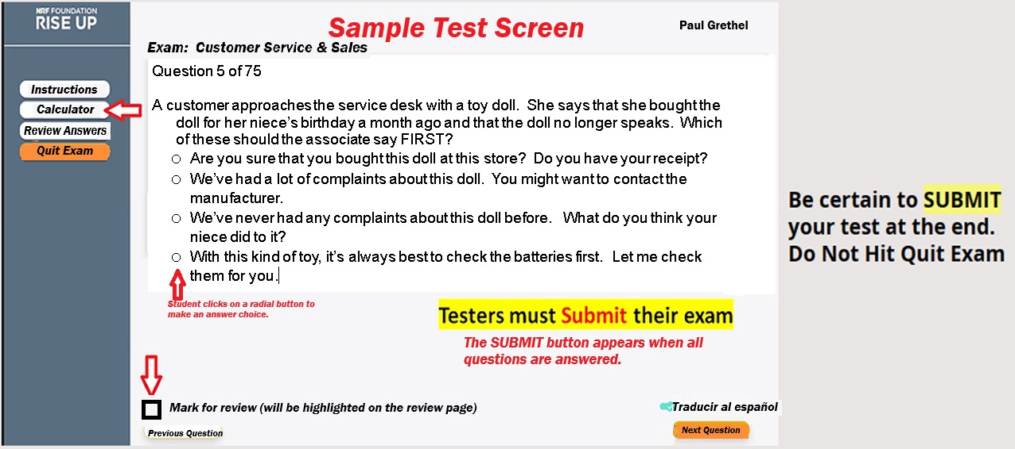
Review what test screen looks like with students
75 questions
90 minutes
Spanish Toggle
Make sure you have students Submit their exam

Slide 56

STUDENTS WHO FAIL THE EXAM
1. You must get a Retake license which will cost $25 each.
​
2. Contact your school district Administrator who has the RiseUp account if you need any
retake licenses. The Administrator will need to make this purchase for you at
$25/retake and should add them to your teacher account.
3. Go to Manage Students (under Hamburger) and assign the student a retake license.
4. Students can retake the exam immediately, but we suggest you have them study
before retaking it.

Slide 57
FEATURES AVAILABLE
You can request text-to-speech for your student exams under accommodations.
A Spanish Helping Translation button is built into the Rise Up exams. You do not need to purchase a separate exam or request this in the accommodations form. The toggle switch is on the bottom right of Queston #1 of the exam.
Download your student’s credential certificate by going to the home page (click RISE Up Platform in upper left corner next to Hamburger to get to home page). Look for the Certificate column over on right side. Find the student and click the small eyeball in the certificate column to download a copy of that student’s certificate.

Slide 58
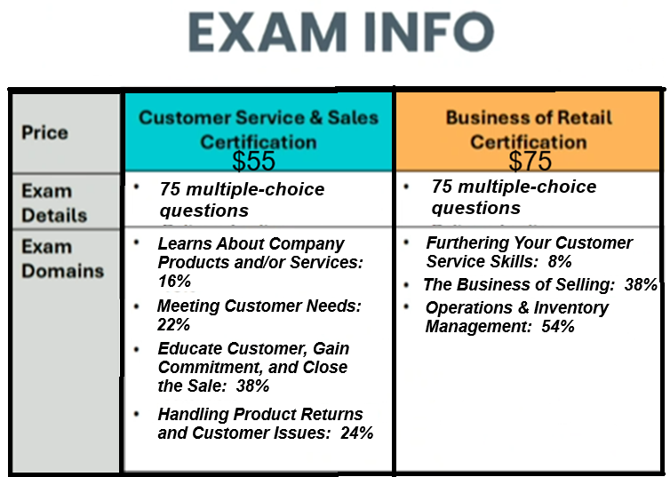
75 multiple-choice questions
Timed: 90 Minutes / Proctored
Certification issued
The areas included in the exam and the emphasis given to each correspond to the knowledge and skills acquired. These areas have been identified through a job task analysis for a student
to succeed within an entry-level role.
Our course material and exams are at a 7th grade reading level
Students need to be at least 14 years old

Slide 59
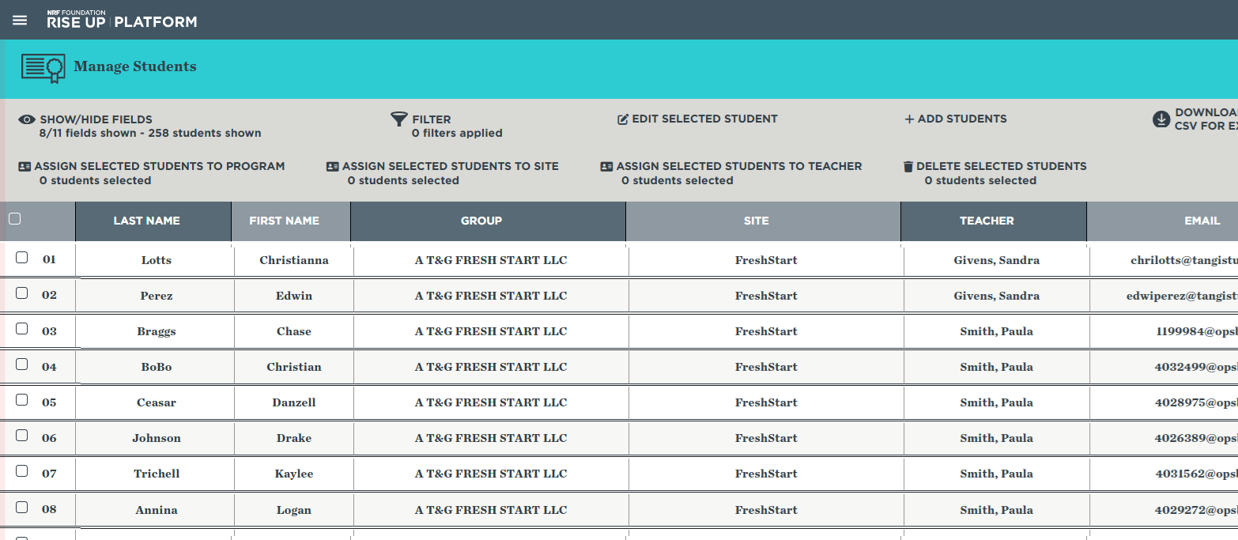
PUTTING STUDENTS IN ALPHABETICAL ORDER
Click Hamburger, then click on Manage Students to see your students

Slide 60

Move your cursor to the area after Last Name and an up arrow appears. Click the up arrow. Keep clicking it until your names appear in alphabetical order.

Slide 61
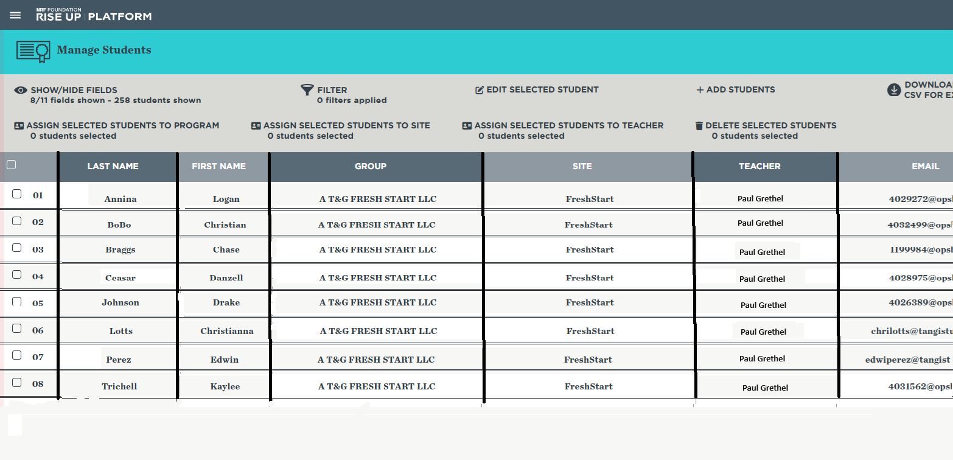
Students are now in alphabetical order which makes it easier to find.

Slide 62
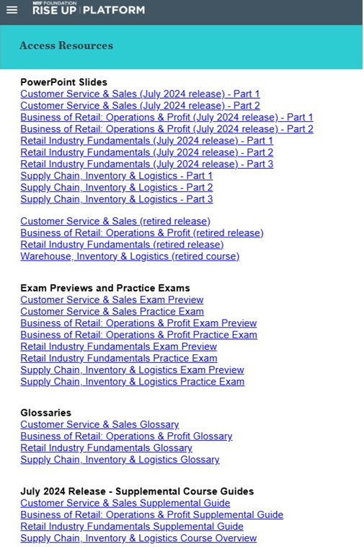
To Download the entire PowerPoint that goes along with the course textbook, click on the hamburger, the click on Access Resources.
Find the one you need, click it and download it. These are enormous files to download.
Also, there practice test, glossaries, and supplement textbook material.
PowerPoints that go with the Teacher textbook
Exam Previews and Practice Tests
Glossaries
Older textbook supplemental material

Slide 63
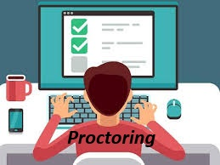
No notes, books or other materials open.
No web searches during exam.
No mobile phone or other electronics in use; no AI usage.
Students must not leave the room for any reason or they forfeit their exam.
If electricity goes out, call Rise Up.
If a student’s test goes offline for any reason, call Rise Up.
If a test cannot be submitted by the student, call Rise Up.
Coordinate with your principal about testing dates so that there are no “planned” fire drills. If there is an unexpected fire alarm, lockdown, or other emergency, call Rise Up.
Student keystrokes are recorded, so Rise Up will investigate any issues to make sure the student did not create the problem. If they did, they will not be given a new license from Rise Up.

Slide 64

During the exam, do NOT:
Minimize your screen
Open another screen at the same time as the test
Use the Back browser button. You should use the Previous Question and Next Question buttons on your exam.
Refresh your screen.
Exit the exam. The proper way to finish your exam is to press SUBMIT
Open any other physical resources or other technology

Slide 65
Do NOT use the A T&G Fresh Start Rise Up account for your students!
This account is only used when we train teachers. When you take either our
Customer Service & Sales class, or
Business of Retail class
You are a STUDENT in our class. Do not use as a teacher.

Slide 66

Any Questions
To get a copy of this presentation, go to www.atgfreshstart.com and click on the Proctor tab. The link to this presentation is at top, right corner.

